Slide 1
Big Data Use Cases
Geoffrey Fox, Indiana University
Based on work of NIST Big Data Public Working Group (NBD-PWG) June-September 2013 http://bigdatawg.nist.gov/
Leaders of activity
Wo Chang, NIST
Robert Marcus, ET-Strategies
Chaitanya Baru, UC San Diego

Slide 2
Introduction to NIST Big Data Public Working Group (NBD-PWG) Requirements and Use Case Subgroup Introduction

Slide 3
Requirements and Use Case Subgroup
The focus is to form a community of interest from industry, academia, and government, with the goal of developing a consensus list of Big Data requirements across all stakeholders. This includes gathering and understanding various use cases from diversified application domains.
Tasks
Gather use case input from all stakeholders
Derive Big Data requirements from each use case.
Analyze/prioritize a list of challenging general requirements that may delay or prevent adoption of Big Data deployment
Develop a set of general patterns capturing the “essence” of use cases (to do)
Work with Reference Architecture to validate requirements and reference architecture by explicitly implementing some patterns based on use cases

Slide 4
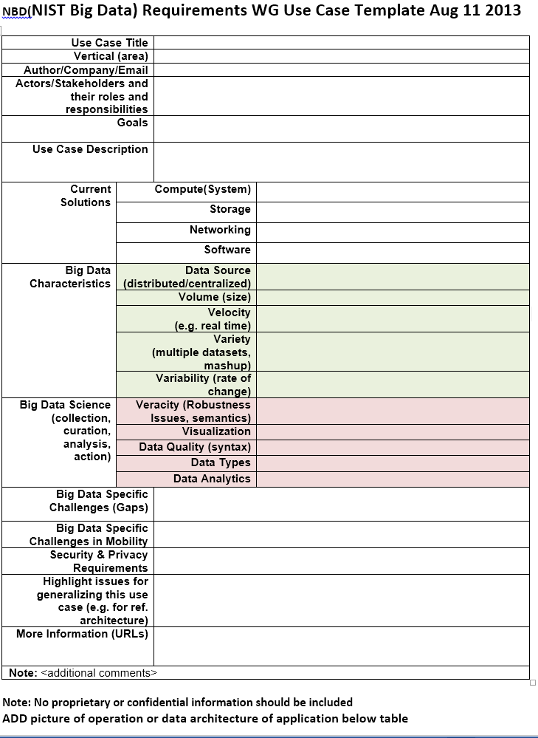
Use Case Template
26 fields completed for 51 areas
Government Operation: 4
Commercial: 8
Defense: 3
Healthcare and Life Sciences: 10
Deep Learning and Social Media: 6
The Ecosystem for Research: 4
Astronomy and Physics: 5
Earth, Environmental and Polar Science: 10
Energy: 1

Slide 5
51 Detailed Use Cases: Many TB’s to Many PB’s
Government Operation: National Archives and Records Administration, Census Bureau
Commercial: Finance in Cloud, Cloud Backup, Mendeley (Citations), Netflix, Web Search, Digital Materials, Cargo shipping (as in UPS)
Defense: Sensors, Image surveillance, Situation Assessment
Healthcare and Life Sciences: Medical records, Graph and Probabilistic analysis, Pathology, Bioimaging, Genomics, Epidemiology, People Activity models, Biodiversity
Deep Learning and Social Media: Driving Car, Geolocate images/cameras, Twitter, Crowd Sourcing, Network Science, NIST benchmark datasets
The Ecosystem for Research: Metadata, Collaboration, Language Translation, Light source experiments
Astronomy and Physics: Sky Surveys compared to simulation, Large Hadron Collider at CERN, Belle Accelerator II in Japan
Earth, Environmental and Polar Science: Radar Scattering in Atmosphere, Earthquake, Ocean, Earth Observation, Ice sheet Radar scattering, Earth radar mapping, Climate simulation datasets, Atmospheric turbulence identification, Subsurface Biogeochemistry (microbes to watersheds), AmeriFlux and FLUXNET gas sensors
Energy: Smart grid

Slide 6
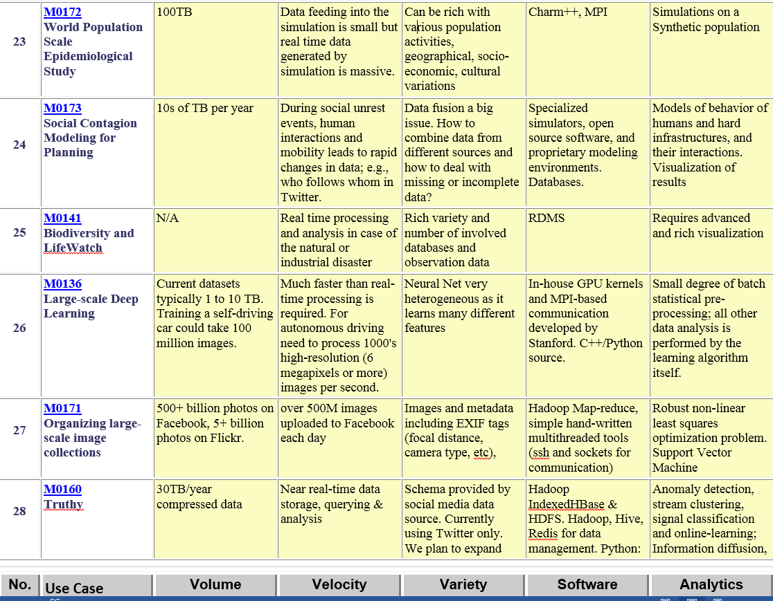
Part of Property Summary Table

Slide 7
Requirements Extraction Process
Two-step process is used for requirement extraction:
Extract specific requirements and map to reference architecture based on each application’s characteristics such as:
data sources (data size, file formats, rate of grow, at rest or in motion, etc.)
data lifecycle management (curation, conversion, quality check, pre-analytic processing, etc.)
data transformation (data fusion/mashup, analytics),
capability infrastructure (software tools, platform tools, hardware resources such as storage and networking), and
data usage (processed results in text, table, visual, and other formats).
all architecture components informed by Goals and use case description
Security & Privacy has direct map
Aggregate all specific requirements into high-level generalized requirements which are vendor-neutral and technology agnostic.

Slide 8
Requirements
437 Requirements were extracted from Use Cases by working group members
This has uncertainties as role and especially categorization of requirements evolved as reference architecture evolved
Each use case has its own set of specific requirements such as:
Requires high volume data transfer to remote batch processing resource
Software needs R, Matlab, Weka, Hadoop
Support data update every 15 minutes
Significant privacy issues requiring anonymization by aggregation
Require rich robust provenance defining complex machine/human processing
Real time and batch mode both needed

Slide 9
Comments on Requirements & Use cases Process
Note sum Σ_{i=0}⁵⁰ ε_{i} can be pretty large however small ε_{i} is
i.e. processing 51 use cases takes a long time even for modest tasks
Future solution would be to automate process so that submitter does most of post-processing tasks
Following material available for use cases http://bigdatawg.nist.gov/usecases.php
Template with 26 fields
“Readable” summary with fields Application, Current Approach, Futures and sometimes pictures
Digest with fields Data Volume, Velocity, Variety (The big 3 V’s), Software, Data Analytics
Set of Specific requirements extracted from each use case with (sometimes) explicit tie to use case
Link between Specific requirements and General requirements

Slide 10
35 General Requirements
These were organized in 7 categories suggested by components of reference architecture
As specific requirements and reference architecture only completed in last days, these could change
Example: Transformation General Requirements (# Specific Requirements generalized)
TPR-1: Needs to support diversified compute intensive, analytic processing and machine learning techniques (38)
TPR-2: Needs to support batch and real time analytic processing (7)
TPR-3: Needs to support processing large diversified data content and modeling (15)
TPR-4: Needs to support processing data in motion (streaming, fetching new content, tracking, etc.) (6)

Slide 11
Size of Process
The draft use case and requirements report is 264 pages
How much web and how much publication?
35 General Requirements
437 Specific Requirements
8.6 per use case, 12.5 per general requirement
Data Sources: 3 General 78 Specific
Transformation: 4 General 60 Specific
Capability (Infrastructure): 6 General 133 Specific
Data Consumer: 6 General 55 Specific
Security & Privacy: 2 General 45 Specific
Lifecycle: 9 General 43 Specific
Other: 5 General 23 Specific

Slide 12
Significant Web Resources
Index to all use cases http://bigdatawg.nist.gov/usecases.php
This links to individual submissions and other processed/collected information
List of specific requirements versus use case http://bigdatawg.nist.gov/uc_reqs_summary.php
List of general requirements versus architecture component http://bigdatawg.nist.gov/uc_reqs_gen.php
List of general requirements versus architecture component with record of use cases giving requirement http://bigdatawg.nist.gov/uc_reqs_gen_ref.php
List of architecture component and specific requirements plus use case constraining this component http://bigdatawg.nist.gov/uc_reqs_gen_detail.php

Slide 13
Next Steps for Requirements & Use-case Process
Review and clean up current draft material
Request clarifications from some submitters
Evaluate – especially with architecture group – requirements
Specific and General
See how particular use cases map into reference architecture
If expect to collect more use cases, decide on more automated (less work by requirements group) process
Set up web use case upload resource

Slide 14
Introduction to NIST Big Data Public Working Group (NBD-PWG) Requirements and Use Case Subgroup Government Use Cases

Slide 15
1: Census 2010 and 2000 – Title 13 Big Data
Government
Application: Preserve Census 2010 and 2000 – Title 13 data for a long term in order to provide access and perform analytics after 75 years. One must maintain data “as-is” with no access and no data analytics for 75 years; one must preserve the data at the bit-level; one must perform curation, which includes format transformation if necessary; one must provide access and analytics after nearly 75 years. Title 13 of U.S. code authorizes the Census Bureau and guarantees that individual and industry specific data is protected.
Current Approach: 380 terabytes of scanned documents
MRStat, S/Q, Index
Parallelism over info from people

Slide 16
2: National Archives and Records Administration Accession NARA, Search, Retrieve, Preservation
Government
Application: Accession, Search, Retrieval, and Long term Preservation of Government Data.
Current Approach: 1) Get physical and legal custody of the data; 2) Pre-process data for virus scan, identifying file format identification, removing empty files; 3) Index; 4) Categorize records (sensitive, unsensitive, privacy data, etc.); 5) Transform old file formats to modern formats (e.g. WordPerfect to PDF); 6) E-discovery; 7) Search and retrieve to respond to special request; 8) Search and retrieve of public records by public users. Currently 100’s of terabytes stored centrally in commercial databases supported by custom software and commercial search products.
Futures: There are distributed data sources from federal agencies where current solution requires transfer of those data to a centralized storage. In the future, those data sources may reside in multiple Cloud environments. In this case, physical custody should avoid transferring big data from Cloud to Cloud or from Cloud to Data Center.
PP, MRStat, S/Q, Index
Parallelism over Government items (some from people), People viewing

Slide 17
3: Census Bureau Statistical Survey Response Improvement (Adaptive Design)
Government
Application: Survey costs are increasing as survey response declines. The goal of this work is to use advanced “recommendation system techniques” that are open and scientifically objective, using data mashed up from several sources and historical survey para-data (administrative data about the survey) to drive operational processes in an effort to increase quality and reduce the cost of field surveys.
Current Approach: About a petabyte of data coming from surveys and other government administrative sources. Data can be streamed with approximately 150 million records transmitted as field data streamed continuously, during the decennial census. All data must be both confidential and secure. All processes must be auditable for security and confidentiality as required by various legal statutes. Data quality should be high and statistically checked for accuracy and reliability throughout the collection process. Use Hadoop, Spark, Hive, R, SAS, Mahout, Allegrograph, MySQL, Oracle, Storm, BigMemory, Cassandra, Pig software.
Futures: Analytics needs to be developed which give statistical estimations that provide more detail, on a more near real time basis for less cost. The reliability of estimated statistics from such “mashed up” sources still must be evaluated.
PP, MRStat, S/Q, Index, CF
Parallelism over Government items (from people), People viewing

Slide 18
4: Non-Traditional Data in Statistical Survey Response Improvement (Adaptive Design)
Government
Application: Survey costs are increasing as survey response declines. This use case has similar goals to that above but involves non-traditional commercial and public data sources from the web, wireless communication, electronic transactions mashed up analytically with traditional surveys to improve statistics for small area geographies, new measures and to improve the timeliness of released statistics.
Current Approach: Integrate survey data, other government administrative data, web scrapped data, wireless data, e-transaction data, potentially social media data and positioning data from various sources. Software, Visualization and data characteristics similar to previous use case.
Futures: Analytics needs to be developed which give statistical estimations that provide more detail, on a more near real time basis for less cost. The reliability of estimated statistics from such “mashed up” sources still must be evaluated.
PP, MRStat, S/Q, Index, CF
Parallelism over Government items (from people), People viewing

Slide 19
Introduction to NIST Big Data Public Working Group (NBD-PWG) Requirements and Use Case Subgroup Commercial Use Cases

Slide 20
5: Cloud Eco-System, for Financial Industries
Commercial
(Banking, Securities & Investments, Insurance) transacting business within the United States
Application: Use of Cloud (Bigdata) technologies needs to be extended in Financial Industries (Banking, Securities & Investments, Insurance).
Current Approach: Currently within Financial Industry, Bigdata and Hadoop are used for fraud detection, risk analysis and assessments as well as improving the organizations knowledge and understanding of the customers. At the same time, the traditional client/server/data warehouse/RDBM (Relational Database Management) systems are used for the handling, processing, storage and archival of the entities financial data. Real time data and analysis important in these applications.
Futures: One must address Security and privacy and regulation such as SEC mandated use of XBRL (extensible Business Related Markup Language) and examine other cloud functions in the Financial industry.
PP, MRStat, S/Q, Index
Streaming
Parallelism over items in bank, People accessing

Slide 21
6: Mendeley – An International Network of Research
Commercial
Application: Mendeley has built a database of research documents and facilitates the creation of shared bibliographies. Mendeley uses the information collected about research reading patterns and other activities conducted via the software to build more efficient literature discovery and analysis tools. Text mining and classification systems enables automatic recommendation of relevant research, improving the cost and performance of research teams, particularly those engaged in curation of literature on a particular subject
Current Approach: Data size is 15TB presently, growing about 1 TB/month. Processing on Amazon Web Services with Hadoop, Scribe, Hive, Mahout, Python. Standard libraries for machine learning and analytics, Latent Dirichlet Allocation, custom built reporting tools for aggregating readership and social activities per document.
Futures: Currently Hadoop batch jobs are scheduled daily, but work has begun on real-time recommendation. The database contains ~400M documents, roughly 80M unique documents, and receives 5-700k new uploads on a weekday. Thus a major challenge is clustering matching documents together in a computationally efficient way (scalable and parallelized) when they’re uploaded from different sources and have been slightly modified via third-part annotation tools or publisher watermarks and cover pages.
PP, MR, MRIter, CF, Classification
Streaming
Parallelism over People and/or Documents

Slide 22
7: Netflix Movie Service
Commercial
Application: Allow streaming of user selected movies to satisfy multiple objectives (for different stakeholders) -- especially retaining subscribers. Find best possible ordering of a set of videos for a user (household) within a given context in real-time; maximize movie consumption. Digital movies stored in cloud with metadata; user profiles and rankings for small fraction of movies for each user. Use multiple criteria – content based recommender system; user-based recommender system; diversity. Refine algorithms continuously with A/B testing.
Current Approach: Recommender systems and streaming video delivery are core Netflix technologies. Recommender systems are always personalized and use logistic/linear regression, elastic nets, matrix factorization, clustering, latent Dirichlet allocation, association rules, gradient boosted decision trees etc. Winner of Netflix competition (to improve ratings by 10%) combined over 100 different algorithms. Uses SQL, NoSQL, MapReduce on Amazon Web Services. Netflix recommender systems have features in common to e-commerce like Amazon. Streaming video has features in common with other content providing services like iTunes, Google Play, Pandora and Last.fm.
Futures: Very competitive business. Need to be aware of other companies and trends in both content (which Movies are hot) and technology. Need to investigate new business initiatives such as Netflix sponsored content
PP, MR, CF, S/Q, Index, Classification
Streaming
Parallelism over People and/or Movies

Slide 23
8: Web Search
Commercial
Application: Return in ~0.1 seconds, the results of a search based on average of 3 words; important to maximize quantities like “precision@10” or number of great responses in top 10 ranked results.
Current Approach: Steps include 1) Crawl the web; 2) Pre-process data to get searchable things (words, positions); 3) Form Inverted Index mapping words to documents; 4) Rank relevance of documents: PageRank; 5) Lots of technology for advertising, “reverse engineering ranking” “preventing reverse engineering”; 6) Clustering of documents into topics (as in Google News) 7) Update results efficiently. Modern clouds and technologies like MapReduce have been heavily influenced by this application. ~45B web pages total.
Futures: A very competitive field where continuous innovation needed. Two important areas are addressing mobile clients which are a growing fraction of users and increasing sophistication of responses and layout to maximize total benefit of clients, advertisers and Search Company. The “deep web” (that behind user interfaces to databases etc.) and multimedia search of increasing importance. 500M photos uploaded each day and 100 hours of video uploaded to YouTube each minute.
PP, MR, MRIter, S/Q, Index, Classification
Streaming
Parallelism over People and web pages

Slide 24
9: IaaS in a Cloud Eco-System Big Data Business Continuity/Disaster Recovery (BC/DR)
Commercial
Application: BC/DR needs to consider the role that the following four areas in continuity and disaster recovery strategy. The four areas are; people (resources), processes (time/cost/ROI), technology (various operating systems, platforms and footprints) and governance (subject to various and multiple regulatory agencies).
Current Approach: Cloud Eco-systems, incorporating IaaS, supported by Tier 3 Data Centers provide data replication services. Replication is different from Backup and only moves the changes since the last time a replication occurs, including block level changes. The replication can be done quickly, with a five second window, while the data is replicated every four hours. This data snap shot is retained for about seven business days. Replicated data can be moved to a Fail-over Center to satisfy an organizations RPO (Recovery Point Objectives) and RTO (Recovery Time Objectives). Technologies used from VMware, NetApps, Oracle, IBM, Brocade. Data sizes are terabytes up to petabytes
Futures: The complexities associated with migrating from a Primary Site to either a Replication Site or a Backup Site is not fully automated at this point in time. The goal is to enable the user to automatically initiate the Fail Over sequence. Both organizations must know which servers have to be restored and what are the dependencies and inter-dependencies between the Primary Site servers and Replication and/or Backup Site servers. This requires a continuous monitoring of both.
PP
Parallelism over Files

Slide 25
10: Cargo Shipping I
Commercial
Application: Monitoring and tracking of cargo as in Fedex, UPS and DHL.
Current Approach: Today the information is updated only when the items that were checked with a bar code scanner are sent to the central server. The location is not currently displayed in real-time.
Futures: This Internet of Things application needs to track items in real time. A new aspect will be status condition of the items which will include sensor information, GPS coordinates, and a unique identification schema based upon a new ISO 29161 standards
See architecture diagram following

Slide 26
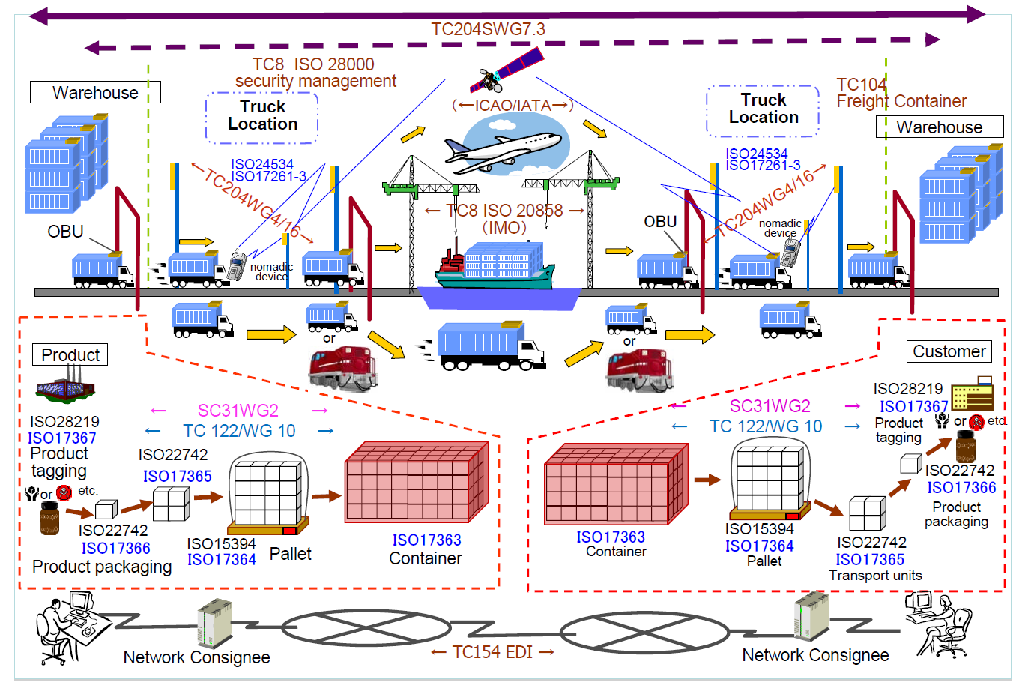
10: Cargo Shipping II
Commercial

Slide 27
11: Materials Data for Manufacturing (Materials informatics )
Commercial
Application: Every physical product is made from a material that has been selected for its properties, cost, and availability. This translates into hundreds of billion dollars of material decisions made every year. However the adoption of new materials normally takes decades (two to three) rather than a small number of years, in part because data on new materials is not easily available. One needs to broaden accessibility, quality, and usability and overcome proprietary barriers to sharing materials data. One must create sufficiently large repositories of materials data to support discovery.
Current Approach: Currently decisions about materials usage are unnecessarily conservative, often based on older rather than newer materials R&D data, and not taking advantage of advances in modeling and simulations.
Futures: Data science can have major impact by predicting the performance of real materials (gram to ton quantities) starting at the atomistic, nanometer, and/or micrometer description. One must establish new fundamental materials data repositories; one must develop internationally-accepted data recording for a diverse materials community, including developers of standards, testing companies, materials producers, and R&D labs; one needs tools and procedures to allow proprietary materials to be in data repositories and usable but with proprietary information masked; one needs high dimension multi-variable materials data visualization tools.
MR, perhaps MRIter, Classification
Streaming
Parallelism over Materials

Slide 28
12: Simulation driven Materials Genomics
Commercial
Application: Innovation of battery technologies through massive simulations spanning wide spaces of possible design. Systematic computational studies of innovation possibilities in photovoltaics. Rational design of materials based on search and simulation. These require management of simulation results contributing to the materials genome.
Current Approach: PyMatGen, FireWorks, VASP, ABINIT, NWChem, BerkeleyGW, and varied materials community codes running on large supercomputers produce survey results.
Futures: Need large scale computing at scale for simulation science. Flexible data methods at scale for messy data. Machine learning and knowledge systems that integrate data from publications, experiments, and simulations to advance goal-driven thinking in materials design. Scalable key-value and object store databases needed. The current 100TB of data will become 500TB in 5 years
HPC
Streaming
Parallelism over Materials except for HPC which is Mesh

Slide 29
Introduction to NIST Big Data Public Working Group (NBD-PWG) Requirements and Use Case Subgroup Defense Use Cases

Slide 30
13: Cloud Large Scale Geospatial Analysis and Visualization
Defense
Application: Need to support large scale geospatial data analysis and visualization with number of geospatially aware sensors and the number of geospatially tagged data sources rapidly increasing.
Current Approach: Traditional GIS systems are generally capable of analyzing a millions of objects and easily visualizing thousands. Data types include Imagery (various formats such as NITF, GeoTiff, CADRG), and vector with various formats like shape files, KML, text streams. Object types include points, lines, areas, polylines, circles, ellipses. Data accuracy very important with image registration and sensor accuracy relevant. Analytics include closest point of approach, deviation from route, and point density over time, PCA and ICA. Software includes Server with Geospatially enabled RDBMS, Geospatial server/analysis software – ESRI ArcServer, Geoserver; Visualization by ArcMap or browser based visualization
Futures: Today’s intelligence systems often contain trillions of geospatial objects and need to be able to visualize and interact with millions of objects. Critical issues are Indexing, retrieval and distributed analysis; Visualization generation and transmission; Visualization of data at the end of low bandwidth wireless connections; Data is sensitive and must be completely secure in transit and at rest (particularly on handhelds); Geospatial data requires unique approaches to indexing and distributed analysis.
PP, GIS, Classification
Streaming
Parallelism over Sensors and people accessing data

Slide 31
14: Object identification and tracking from Wide Area Large Format Imagery (WALF) Imagery or Full Motion Video (FMV) – Persistent Surveillance
Defense
Application: Persistent surveillance sensors can easily collect petabytes of imagery data in the space of a few hours. The data should be reduced to a set of geospatial object (points, tracks, etc.) which can easily be integrated with other data to form a common operational picture. Typical processing involves extracting and tracking entities (vehicles, people, packages) over time from the raw image data.
Current Approach: The data needs to be processed close to the sensor which is likely forward deployed since data is too large to be easily transmitted. Typical object extraction systems are currently small (1-20 node) GPU enhanced clusters. There are a wide range of custom software and tools including traditional RDBMS’s and display tools. Real time data obtained at FMV (Full Motion Video) – 30-60 frames per/sec at full color 1080P resolution or WALF (Wide Area Large Format) with 1-10 frames per/sec at 10Kx10K full color resolution. Visualization of extracted outputs will typically be as overlays on a geospatial (GIS) display. Analytics are basic object detection analytics and integration with sophisticated situation awareness tools with data fusion. Significant security issues to ensure the enemy is not able to know what we see.
Futures: Typical problem is integration of this processing into a large (GPU) cluster capable of processing data from several sensors in parallel and in near real time. Transmission of data from sensor to system is also a major challenge.
PP, GIS, MR, MRIter? Classification
Streaming
31
Parallelism over Sensors and people accessing data

Slide 32
15: Intelligence Data Processing and Analysis
Defense
Application: Allow Intelligence Analysts to a) Identify relationships between entities (people, organizations, places, equipment) b) Spot trends in sentiment or intent for either general population or leadership group (state, non-state actors) c) Find location of and possibly timing of hostile actions (including implantation of IEDs) d) Track the location and actions of (potentially) hostile actors e) Ability to reason against and derive knowledge from diverse, disconnected, and frequently unstructured (e.g. text) data sources f) Ability to process data close to the point of collection and allow data to be shared easily to/from individual soldiers, forward deployed units, and senior leadership in garrison.
Current Approach: Software includes Hadoop, Accumulo (Big Table), Solr, Natural Language Processing, Puppet (for deployment and security) and Storm running on medium size clusters. Data size in 10s of Terabytes to 100s of Petabytes with Imagery intelligence device gathering petabyte in a few hours. Dismounted warfighters would have at most 1-100s of Gigabytes (typically handheld data storage).
Futures: Data currently exists in disparate silos which must be accessible through a semantically integrated data space. Wide variety of data types, sources, structures, and quality which will span domains and requires integrated search and reasoning. Most critical data is either unstructured or imagery/video which requires significant processing to extract entities and information. Network quality, Provenance and security essential.
GIS, MR, MRIter?, Classification
Streaming
Parallelism over Sensors and people accessing data

Slide 33
16: Electronic Medical Record (EMR) Data I
Healthcare
Life Sciences
Application: Large national initiatives around health data are emerging, and include developing a digital learning health care system to support increasingly evidence-based clinical decisions with timely accurate and up-to-date patient-centered clinical information; using electronic observational clinical data to efficiently and rapidly translate scientific discoveries into effective clinical treatments; and electronically sharing integrated health data to improve healthcare process efficiency and outcomes. These key initiatives all rely on high-quality, large-scale, standardized and aggregate health data. One needs advanced methods for normalizing patient, provider, facility and clinical concept identification within and among separate health care organizations to enhance models for defining and extracting clinical phenotypes from non-standard discrete and free-text clinical data using feature selection, information retrieval and machine learning decision-models. One must leverage clinical phenotype data to support cohort selection, clinical outcomes research, and clinical decision support.
PP, Fusion, S/Q, Index
Streaming
Parallelism over EMR (a set per person), viewers

Slide 34
Introduction to NIST Big Data Public Working Group (NBD-PWG) Requirements and Use Case Subgroup Healthcare and Life Science Use Cases

Slide 35
16: Electronic Medical Record (EMR) Data II
Healthcare
Life Sciences
Current Approach: Clinical data from more than 1,100 discrete logical, operational healthcare sources in the Indiana Network for Patient Care (INPC) the nation's largest and longest-running health information exchange. This describes more than 12 million patients, more than 4 billion discrete clinical observations. > 20 TB raw data. Between 500,000 and 1.5 million new real-time clinical transactions added per day.
Futures: Teradata, PostgreSQL and MongoDB supporting information retrieval methods to identify relevant clinical features (tf-idf, latent semantic analysis, mutual information). Natural Language Processing techniques to extract relevant clinical features. Validated features will be used to parameterize clinical phenotype decision models based on maximum likelihood estimators and Bayesian networks. Decision models will be used to identify a variety of clinical phenotypes such as diabetes, congestive heart failure, and pancreatic cancer.

Slide 36
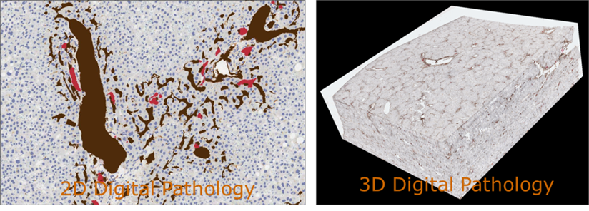
17:Pathology Imaging/ Digital Pathology I
Healthcare
Life Sciences
Application: Digital pathology imaging is an emerging field where examination of high resolution images of tissue specimens enables novel and more effective ways for disease diagnosis. Pathology image analysis segments massive (millions per image) spatial objects such as nuclei and blood vessels, represented with their boundaries, along with many extracted image features from these objects. The derived information is used for many complex queries and analytics to support biomedical research and clinical diagnosis.
MR, MRIter, PP, Classification
Streaming
Parallelism over Images

Slide 37
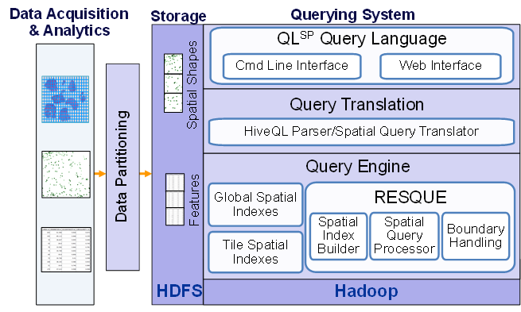
17:Pathology Imaging/ Digital Pathology II
Healthcare
Life Sciences
Current Approach: 1GB raw image data + 1.5GB analytical results per 2D image. MPI for image analysis; MapReduce + Hive with spatial extension on supercomputers and clouds. GPU’s used effectively. Figure 3 of section 2.12 shows the architecture of Hadoop-GIS, a spatial data warehousing system over MapReduce to support spatial analytics for analytical pathology imaging.
Futures: Recently, 3D pathology imaging is made possible through 3D laser technologies or serially sectioning hundreds of tissue sections onto slides and scanning them into digital images. Segmenting 3D microanatomic objects from registered serial images could produce tens of millions of 3D objects from a single image. This provides a deep “map” of human tissues for next generation diagnosis. 1TB raw image data + 1TB analytical results per 3D image and 1PB data per moderated hospital per year.
Architecture of Hadoop-GIS, a spatial data warehousing system over MapReduce to support spatial analytics for analytical pathology imaging

Slide 38
18: Computational Bioimaging
Healthcare
Life Sciences
Application: Data delivered from bioimaging is increasingly automated, higher resolution, and multi-modal. This has created a data analysis bottleneck that, if resolved, can advance the biosciences discovery through Big Data techniques.
Current Approach: The current piecemeal analysis approach does not scale to situation where a single scan on emerging machines is 32TB and medical diagnostic imaging is annually around 70 PB even excluding cardiology. One needs a web-based one-stop-shop for high performance, high throughput image processing for producers and consumers of models built on bio-imaging data.
Futures: Goal is to solve that bottleneck with extreme scale computing with community-focused science gateways to support the application of massive data analysis toward massive imaging data sets. Workflow components include data acquisition, storage, enhancement, minimizing noise, segmentation of regions of interest, crowd-based selection and extraction of features, and object classification, and organization, and search. Use ImageJ, OMERO, VolRover, advanced segmentation and feature detection software.
MR, MRIter?, PP, Classification
Streaming
Parallelism over Images

Slide 39
19: NIST Genome in a Bottle Consortium
Healthcare
Life Sciences
Application: NIST/Genome in a Bottle Consortium integrates data from multiple sequencing technologies and methods to develop highly confident characterization of whole human genomes as reference materials, and develop methods to use these Reference Materials to assess performance of any genome sequencing run.
Current Approach: The storage of ~40TB NFS at NIST is full; there are also PBs of genomics data at NIH/NCBI. Use Open-source sequencing bioinformatics software from academic groups (UNIX-based) on a 72 core cluster at NIST supplemented by larger systems at collaborators.
Futures: DNA sequencers can generate ~300GB compressed data/day which volume has increased much faster than Moore’s Law. Future data could include other ‘omics’ measurements, which will be even larger than DNA sequencing. Clouds have been explored.
PP, MR, MRIter, Classification
Streaming
Parallelism over Gene fragments at various stages

Slide 40
20: Comparative analysis for metagenomes and genomes
Healthcare
Life Sciences
Application: Given a metagenomic sample, (1) determine the community composition in terms of other reference isolate genomes, (2) characterize the function of its genes, (3) begin to infer possible functional pathways, (4) characterize similarity or dissimilarity with other metagenomic samples, (5) begin to characterize changes in community composition and function due to changes in environmental pressures, (6) isolate sub-sections of data based on quality measures and community composition.
Current Approach: Integrated comparative analysis system for metagenomes and genomes, front ended by an interactive Web UI with core data, backend precomputations, batch job computation submission from the UI. Provide interface to standard bioinformatics tools (BLAST, HMMER, multiple alignment and phylogenetic tools, gene callers, sequence feature predictors…).
Futures: Management of heterogeneity of biological data is currently performed by RDMS (Oracle). Unfortunately, it does not scale for even the current volume 50TB of data. NoSQL solutions aim at providing an alternative but unfortunately they do not always lend themselves to real time interactive use, rapid and parallel bulk loading, and sometimes have issues regarding robustness.
PP, MR, MRIter, Classification
Streaming
Parallelism over Gene fragments at various stages

Slide 41
21: Individualized Diabetes Management
Healthcare
Life Sciences
Application: Diabetes is a growing illness in world population, affecting both developing and developed countries. Current management strategies do not adequately take into account of individual patient profiles, such as co-morbidities and medications, which are common in patients with chronic illnesses. Need to use advanced graph-based data mining techniques applied to EHR converted into a RDF graph, to search for Diabetes patients and extract their EHR data for outcome evaluation.
Current Approach: Typical patient data records composed of 100 controlled vocabulary values and 1000 continuous values. Most values have a timestamp. Need to change traditional paradigm of relational row-column lookup to semantic graph traversal.
Futures: Identify similar patients from a large Electronic Health Record (EHR) database, i.e. an individualized cohort, and evaluate their respective management outcomes to formulate most appropriate solution suited for a given patient with diabetes. Use efficient parallel retrieval algorithms, using open source Hbase with both indexed and custom search to identify patients of possible interest. Use Semantic Linking for Property Values method to convert an existing data warehouse at Mayo Clinic, called the Enterprise Data Trust (EDT), into RDF triples that enables one to find similar patients through linking of both vocabulary-based and continuous values. The time dependent properties need to be found before query to allow matching based on derivatives and other derived properties.
MR, Graph
Streaming
Parallelism over People and their EMR

Slide 42
22: Statistical Relational Artificial Intelligence for Health Care
Healthcare
Life Sciences
Application: The goal of the project is to analyze large, multi-modal medical data including different data types such as imaging, EHR, genetic and natural language. This approach employs the relational probabilistic models that have the capability of handling rich relational data and modeling uncertainty using probability theory. The software learns models from multiple data types and can possibly integrate the information and reason about complex queries. Users can provide a set of descriptions – say for instance, MRI images and demographic data about a particular subject. They can then query for the onset of a particular disease (say Alzheimer’s) and the system will then provide a probability distribution over the possible occurrence of this disease.
Current Approach: A single server can handle a test cohort of a few hundred patients with associated data of 100’s of GB.
Futures: A cohort of millions of patient can involve petabyte datasets. Issues include availability of too much data (as images, genetic sequences etc) that complicate analysis. A major challenge lies in aligning the data and merging from multiple sources in a form that can be made useful for a combined analysis. Another issue is that sometimes, large amount of data is available about a single subject but the number of subjects themselves is not very high (i.e., data imbalance). This can result in learning algorithms picking up random correlations between the multiple data types as important features in analysis.
MRIter, EGO
Streaming
Parallelism over People and their EMR

Slide 43
23: World Population Scale Epidemiological Study
Healthcare
Life Sciences
Application: One needs reliable real-time prediction and control of pandemic similar to the 2009 H1N1 influenza. In general one is addressing contagion diffusion of various kinds: information, diseases, social unrest can be modeled and computed. All of them can be addressed by agent-based models that utilize the underlying interaction network to study the evolution of the desired phenomena.
Current Approach: (a) Build a synthetic global population. (b) Run simulations over the global population to reason about outbreaks and various intervention strategies. Current 100TB dataset generated centrally with MPI based simulation system written in Charm++. Parallelism is achieved by exploiting the disease residence time period.
Futures: Use large social contagion models to study complex global scale issues
MRIter, Agent
Parallelism over People and other modelled entities (vehicles)

Slide 44
24: Social Contagion Modeling for Planning, Public Health and Disaster Management
Healthcare
Life Sciences
Application: Model Social behavior including national security, public health, viral marketing, city planning, disaster preparedness. In a social unrest application, people take to the streets to voice unhappiness with government leadership. There are citizens that both support and oppose government. Quantify the degrees to which normal business and activities are disrupted owing to fear and anger. Quantify the possibility of peaceful demonstrations, violent protests. Quantify the potential for government responses ranging from appeasement, to allowing protests, to issuing threats against protestors, to actions to thwart protests. To address these issues, must have fine-resolution models (at level of individual people, vehicles, and buildings) and datasets.
Current Approach: The social contagion model infrastructure includes different types of human-to-human interactions (e.g., face-to-face versus online media) to be simulated. It takes not only human-to-human interactions into account, but also interactions among people, services (e.g., transportation), and infrastructure (e.g., internet, electric power). These activity models are generated from averages like census data.
Futures: Data fusion a big issue; how should one combine data from different sources and how to deal with missing or incomplete data? Take into account heterogeneous features of 100s of millions or billions of individuals, models of cultural variations across countries that are assigned to individual agents? How to validate these large models?
MRIter, Graph, Agent, EGO
Parallelism over People and other modelled entities (vehicles)

Slide 45
25: Biodiversity and LifeWatch
Healthcare
Life Sciences
Application: Research and monitor different ecosystems, biological species, their dynamics and migration with a mix of custom sensors and data access/processing and a federation with relevant projects in area. Particular case studies: Monitoring alien species, monitoring migrating birds, wetlands. See ENVRI for integration of LifeWatch with other environmental e-infrastructures.
Futures: LifeWatch initiative will provide integrated access to a variety of data, analytical and modeling tools as served by a variety of collaborating initiatives. Another service is offered with data and tools in selected workflows for specific scientific communities. In addition, LifeWatch will provide opportunities to construct personalized ‘virtual labs', also allowing one to enter new data and analytical tools. New data will be shared with the data facilities cooperating with LifeWatch. LifeWatch operates the Global Biodiversity Information facility and Biodiversity Catalogue that is Biodiversity Science Web Services Catalogue. Data includes ‘omics, species information, ecological information (such as biomass, population density etc.), ecosystem data (such as CO2 fluxes. Algal blooming, water and soil characteristics)
GIS, PP
Streaming
Parallelism over generalized sensors

Slide 46
Introduction to NIST Big Data Public Working Group (NBD-PWG) Requirements and Use Case Subgroup Deep Learning and Social Networks Use Cases

Slide 47
26: Large-scale Deep Learning
Deep Learning
Social Networking
Application: Large models (e.g., neural networks with more neurons and connections) combined with large datasets are increasingly the top performers in benchmark tasks for vision, speech, and Natural Language Processing. One needs to train a deep neural network from a large (>>1TB) corpus of data (typically imagery, video, audio, or text). Such training procedures often require customization of the neural network architecture, learning criteria, and dataset pre-processing. In addition to the computational expense demanded by the learning algorithms, the need for rapid prototyping and ease of development is extremely high.
Current Approach: The largest applications so far are to image recognition and scientific studies of unsupervised learning with 10 million images and up to 11 billion parameters on a 64 GPU HPC Infiniband cluster. Both supervised (using existing classified images) and unsupervised applications
Futures: Large datasets of 100TB or more may be necessary in order to exploit the representational power of the larger models. Training a self-driving car could take 100 million images at megapixel resolution. Deep Learning shares many characteristics with the broader field of machine learning. The paramount requirements are high computational throughput for mostly dense linear algebra operations, and extremely high productivity for researcher exploration. One needs integration of high performance libraries with high level (python) prototyping environments
Classified OUT
IN
MRIter,EGO Classification
Parallelism over Nodes in NN, Data being classified

Slide 48
27: Organizing large-scale, unstructured collections of consumer photos I
Deep Learning
Social Networking
Application: Produce 3D reconstructions of scenes using collections of millions to billions of consumer images, where neither the scene structure nor the camera positions are known a priori. Use resulting 3d models to allow efficient browsing of large-scale photo collections by geographic position. Geolocate new images by matching to 3d models. Perform object recognition on each image. 3d reconstruction posed as a robust non-linear least squares optimization problem where observed relations between images are constraints and unknowns are 6-d camera pose of each image and 3-d position of each point in the scene.
Current Approach: Hadoop cluster with 480 cores processing data of initial applications. Note over 500 billion images on Facebook and over 5 billion on Flickr with over 500 million images added to social media sites each day.
EGO, GIS, MR, Classification
Parallelism over Photos

Slide 49
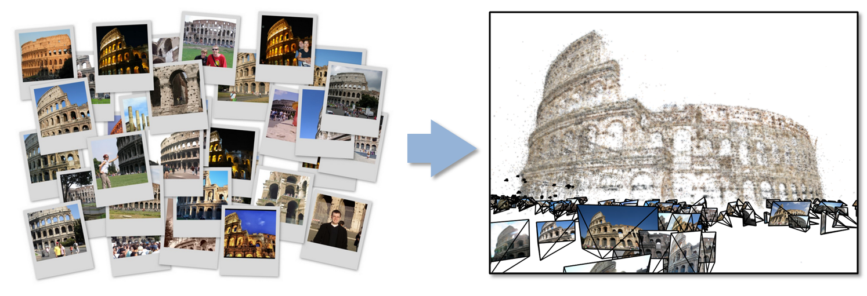
27: Organizing large-scale, unstructured collections of consumer photos II
Deep Learning
Social Networking
Futures: Need many analytics including feature extraction, feature matching, and large-scale probabilistic inference, which appear in many or most computer vision and image processing problems, including recognition, stereo resolution, and image denoising. Need to visualize large-scale 3-d reconstructions, and navigate large-scale collections of images that have been aligned to maps.

Slide 50
28: Truthy: Information diffusion research from Twitter Data
Deep Learning
Social Networking
Application: Understanding how communication spreads on socio-technical networks. Detecting potentially harmful information spread at the early stage (e.g., deceiving messages, orchestrated campaigns, untrustworthy information, etc.)
Current Approach: 1) Acquisition and storage of a large volume (30 TB a year compressed) of continuous streaming data from Twitter (~100 million messages per day, ~500GB data/day increasing over time); (2) near real-time analysis of such data, for anomaly detection, stream clustering, signal classification and online-learning; (3) data retrieval, big data visualization, data-interactive Web interfaces, public API for data querying. Use Python/SciPy/NumPy/MPI for data analysis. Information diffusion, clustering, and dynamic network visualization capabilities already exist
Futures: Truthy plans to expand incorporating Google+ and Facebook. Need to move towards Hadoop/IndexedHBase & HDFS distributed storage. Use Redis as an in-memory database to be a buffer for real-time analysis. Need streaming clustering, anomaly detection and online learning.
Index, S/Q, MR, MRIter, Graph, Classification
Streaming
Parallelism over Tweets

Slide 51
29: Crowd Sourcing in the Humanities as Source for Big and Dynamic Data
Deep Learning
Social Networking
Application: Capture information (manually entered, recorded multimedia, reaction times, pictures, sensor information) from many individuals and their devices and so characterize wide ranging individual, social, cultural and linguistic variation among several dimensions (space, social space, time).
Current Approach: Use typically XML technology, traditional relational databases, and besides pictures not much multi-media yet.
Futures: Crowd sourcing has been barely started to be used on a larger scale but with the availability of mobile devices, now there is a huge potential for collecting much data from many individuals, also making use of sensors in mobile devices. This has not been explored on a large scale so far; existing projects of crowd sourcing are usually of a limited scale and web-based. Privacy issues may be involved (A/V from individuals), anonymization may be necessary but not always possible. Data management and curation critical. Size could be hundreds of terabytes with multimedia.
Fusion
Streaming
Parallelism over Crowd (people) and people related sensors

Slide 52
30: CINET: Cyberinfrastructure for Network (Graph) Science and Analytics
Deep Learning
Social Networking
Application: CINET provides a common web-based platform for accessing various (i) network and graph analysis tools such as SNAP, NetworkX, Galib, etc. (ii) real-world and synthetic networks, (iii) computing resources and (iv) data management systems to the end-user in a seamless manner.
Current Approach: CINET uses an Infiniband connected high performance computing cluster with 720 cores to provide HPC as a service. It is being used for research and education.
Futures: As the repository grows, we expect a rapid growth to lead to over 1000-5000 networks and methods in about a year. As more fields use graphs of increasing size, parallel algorithms will be important. Data manipulation and bookkeeping of the derived data for users is a challenge there are no well-defined and effective models and tools for management of various graph data in a unified fashion.
Graph
Streaming
Parallelism over Users and units of items stored (Tweets, graph nodes)

Slide 53
31: NIST Information Access Division analytic technology performance measurement, evaluations, and standards
Deep Learning
Social Networking
Application: Develop performance metrics, measurement methods, and community evaluations to ground and accelerate the development of advanced analytic technologies in the areas of speech and language processing, video and multimedia processing, biometric image processing, and heterogeneous data processing as well as the interaction of analytics with users. Typically employ one of two processing models: 1) Push test data out to test participants and analyze the output of participant systems, 2) Push algorithm test harness interfaces out to participants and bring in their algorithms and test them on internal computing clusters.
Current Approach: Large annotated corpora of unstructured/semi-structured text, audio, video, images, multimedia, and heterogeneous collections of the above including ground truth annotations for training, developmental testing, and summative evaluations. The test corpora exceed 900M Web pages occupying 30 TB of storage, 100M tweets, 100M ground-truthed biometric images, several hundred thousand partially ground-truthed video clips, and terabytes of smaller fully ground-truthed test collections.
Futures: Even larger data collections are being planned for future evaluations of analytics involving multiple data streams and very heterogeneous data. As well as larger datasets, future includes testing of streaming algorithms with multiple heterogeneous data. Use of clouds being explored.
ML, MR, MRIter, Classification
Streaming
Parallelism over items in corpus

Slide 54
Introduction to NIST Big Data Public Working Group (NBD-PWG) Requirements and Use Case Subgroup Research Ecosystem Use Cases

Slide 55
32: DataNet Federation Consortium DFC I
Research Ecosystem
Application: Promote collaborative and interdisciplinary research through federation of data management systems across federal repositories, national academic research initiatives, institutional repositories, and international collaborations. The collaboration environment runs at scale: petabytes of data, hundreds of millions of files, hundreds of millions of metadata attributes, tens of thousands of users, and a thousand storage resources
Current Approach: Currently 25 science and engineering domains have projects that rely on the iRODS (Integrated Rule Oriented Data System) policy-based data management system including major NSF projects such as Ocean Observatories Initiative (sensor archiving); Temporal Dynamics of Learning Center (Cognitive science data grid); the iPlant Collaborative (plant genomics); Drexel engineering digital library; Odum Institute for social science research (data grid federation with Dataverse). iRODS currently manages petabytes of data, hundreds of millions of files, hundreds of millions of metadata attributes, tens of thousands of users, and a thousand storage resources. It interoperates with workflow systems (NCSA Cyberintegrator, Kepler, Taverna), cloud and more traditional storage models and different transport protocols.
Index, S/Q
Streaming
Parallelism over Data in project

Slide 56
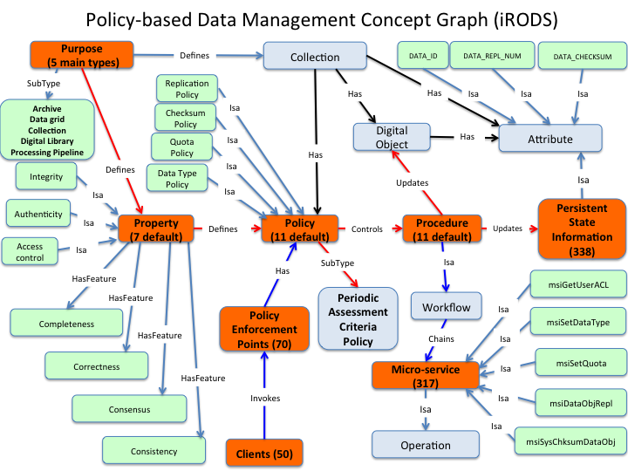
32: DataNet Federation Consortium DFC II
Research Ecosystem
DataNet Federation Consortium DFC iRODS architecture

Slide 57
33: The ‘Discinnet process’, metadata <-> big data global experiment
Research Ecosystem
Application: Discinnet has developed a web 2.0 collaborative platform and research prototype as a pilot installation now being deployed and tested by researchers from a growing number and diversity of research fields through communities belonging a diversity of domains.
Its goal is to reach a wide enough sample of active research fields represented as clusters–researchers projected and aggregating within a manifold of mostly shared experimental dimensions–to test general, hence potentially interdisciplinary, epistemological models throughout the present decade.
Current Approach: Currently 35 clusters started with close to 100 awaiting more resources and potentially much more open for creation, administration and animation by research communities. Examples range from optics, cosmology, materials, microalgae, health to applied math, computation, rubber and other chemical products/issues.
Futures: Discinnet itself would not be Bigdata but rather will generate metadata when applied to a cluster that involves Bigdata. In interdisciplinary integration of several fields, the process would reconcile metadata from many complexity levels.
MR, MRIter?
Streaming
Parallelism over Research data and publications in field

Slide 58
34: Semantic Graph-search on Scientific Chemical and Text-based Data
Research Ecosystem
Application: : Establish social media-based infrastructure, terminology and semantic data-graphs to annotate and present technology information using ‘root’ and rule-based methods used primarily by some Indo-European languages like Sanskrit and Latin.
Current Approach: Many reports, including a recent one on Material Genome Project finds that exclusive top-down solutions to facilitate data sharing and integration are not desirable for federated multi-disciplinary efforts. However, a bottom-up approach can be chaotic. For this reason, there is need for a balanced blend of the two approaches to support easy-to-use techniques to metadata creation, integration and sharing.
Futures: Create a cloud infrastructure for social media of scientific information where scientists globally can participate and deposit results of their experiment. We need to: a) Minimize challenges related to establishing re-usable, inter-disciplinary, scalable, on-demand, use-case and user-friendly vocabulary. b) Adopt an existing or create new on-demand ‘data-graph’ to place an information in an intuitive way such that it would easily integrate with existing ‘data-graphs’ in a federated environment. c) Find relevant scientific data. Start with resources like the Open Government movement, Material genome Initiative and Protein Databank. Good database tools and servers for data-graph manipulation are needed.
MR, MRIter?, Classification
Streaming
Parallelism over Characters in Documents

Slide 59
35: Light source beamlines
Research Ecosystem
Application: Samples are exposed to X-rays from light sources in a variety of configurations depending on the experiment. Detectors (essentially high-speed digital cameras) collect the data. The data are then analyzed to reconstruct a view of the sample or process being studied.
Current Approach: A variety of commercial and open source software is used for data analysis – examples including Octopus for Tomographic Reconstruction, Avizo (http://vsg3d.com) and FIJI (a distribution of ImageJ) for Visualization and Analysis. Data transfer is accomplished using physical transport of portable media (severely limits performance) or using high-performance GridFTP, managed by Globus Online or workflow systems such as SPADE.
Futures: Camera resolution is continually increasing. Data transfer to large-scale computing facilities is becoming necessary because of the computational power required to conduct the analysis on time scales useful to the experiment. Large number of beamlines (e.g. 39 at LBNL ALS) means that total data load is likely to increase significantly and require a generalized infrastructure for analyzing gigabytes per second of data from many beamline detectors at multiple facilities.
PP
Parallelism over Images

Slide 60
Introduction to NIST Big Data Public Working Group (NBD-PWG) Requirements and Use Case Subgroup Astronomy and Physics Use Cases

Slide 61
36: Catalina Real-Time Transient Survey (CRTS): a digital, panoramic, synoptic sky survey I
Astronomy & Physics
Application: The survey explores the variable universe in the visible light regime, on time scales ranging from minutes to years, by searching for variable and transient sources. It discovers a broad variety of astrophysical objects and phenomena, including various types of cosmic explosions (e.g., Supernovae), variable stars, phenomena associated with accretion to massive black holes (active galactic nuclei) and their relativistic jets, high proper motion stars, etc. The data are collected from 3 telescopes (2 in Arizona and 1 in Australia), with additional ones expected in the near future (in Chile).
Current Approach: The survey generates up to ~ 0.1 TB on a clear night with a total of ~100 TB in current data holdings. The data are preprocessed at the telescope, and transferred to Univ. of Arizona and Caltech, for further analysis, distribution, and archiving. The data are processed in real time, and detected transient events are published electronically through a variety of dissemination mechanisms, with no proprietary withholding period (CRTS has a completely open data policy). Further data analysis includes classification of the detected transient events, additional observations using other telescopes, scientific interpretation, and publishing. In this process, it makes a heavy use of the archival data (several PB’s) from a wide variety of geographically distributed resources connected through the Virtual Observatory (VO) framework.
PP, ML, Classification
Streaming
Parallelism over Images and Events: Celestial events identified in Telescope Images

Slide 62
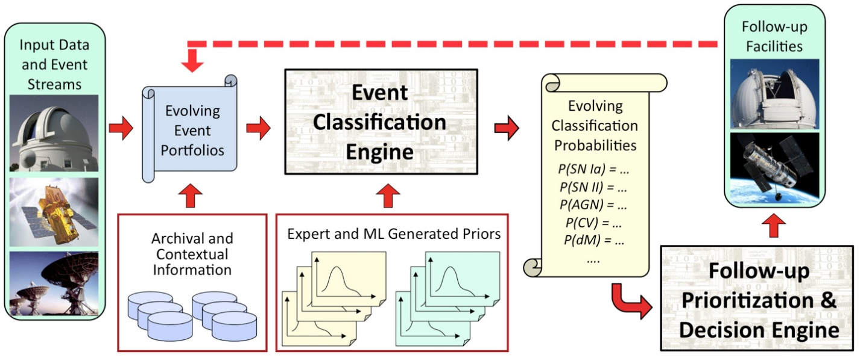
36: Catalina Real-Time Transient Survey (CRTS): a digital, panoramic, synoptic sky survey II
Astronomy & Physics
Futures: CRTS is a scientific and methodological testbed and precursor of larger surveys to come, notably the Large Synoptic Survey Telescope (LSST), expected to operate in 2020’s and selected as the highest-priority ground-based instrument in the 2010 Astronomy and Astrophysics Decadal Survey. LSST will gather about 30 TB per night.

Slide 63
36: Catalina Real-Time Transient Survey (CRTS): a digital, panoramic, synoptic sky survey IIi
Astronomy & Physics
One possible schematic architecture for a cyber-infrastructure for time domain astronomy. (description of picture on previous slide)
Transient event data streams are produced by survey pipelines from the telescopes on the ground or in space, and the events with their observational descriptions are ingested by one or more depositories, from which they can be disseminated electronically to human astronomers or robotic telescopes. Each event is assigned an evolving portfolio of information, which would include all of the available data on that celestial position, from a wide variety of data archives unified under the Virtual Observatory framework, expert annotations, etc. Representations of such federated information can be both human-readable and machine-readable. They are fed into one or more automated event characterization, classification, and prioritization engines that deploy a variety of machine learning tools for these tasks. Their output, which evolves dynamically as new information arrives and is processed, informs the follow-up observations of the selected events, and the resulting data are communicated back to the event portfolios, for the next iteration. Users (human or robotic) can tap into the system at multiple points, both for an information retrieval, and to contribute new information, through a standardized set of formats and protocols. This could be done in a (near) real time, or in an archival (not time critical) modes

Slide 64
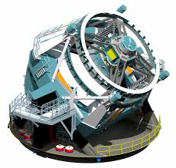
37: DOE Extreme Data from Cosmological Sky Survey and Simulations
Astronomy & Physics
Application: A cosmology discovery tool that integrates simulations and observation to clarify the nature of dark matter, dark energy, and inflation, some of the most exciting, perplexing, and challenging questions facing modern physics including the properties of fundamental particles affecting the early universe. The simulations will generate comparable data sizes to observation.
Futures: Data sizes are Dark Energy Survey (DES) 4 PB in 2015; Zwicky Transient Factory (ZTF) 1 PB/year in 2015 (Mount Palomar); Large Synoptic Sky Survey (LSST see CRTS description) 7 PB/year in 2019; Simulations > 10 PB in 2017. Huge amounts of supercomputer time (over 200M hours) will be used.
LSST to be placed in Chile with 3.2 gigapixel camera with picture taken every 20 secs
Fusion, HPC
Streaming
Parallelism over stars in images and simulations

Slide 65
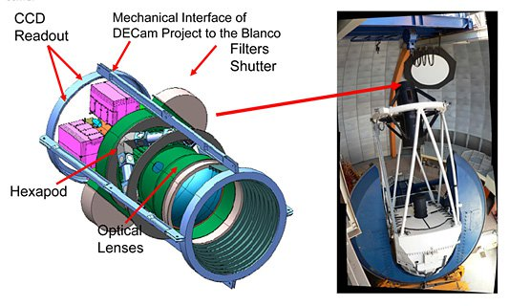
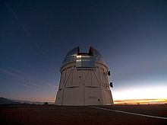
38: Large Survey Data for Cosmology
Astronomy & Physics
Application: For DES (Dark Energy Survey) the data are sent from the mountaintop via a microwave link to La Serena, Chile. From there, an optical link forwards them to the NCSA as well as NERSC for storage and "reduction”. Here galaxies and stars in both the individual and stacked images are identified, catalogued, and finally their properties measured and stored in a database.
Current Approach: Subtraction pipelines are run using extant imaging data to find new optical transients through machine learning algorithms. Linux cluster, Oracle RDBMS server, Postgres PSQL, large memory machines, standard Linux interactive hosts, GPFS. For simulations, HPC resources. Standard astrophysics reduction software as well as Perl/Python wrapper scripts, Linux Cluster scheduling.
Futures: Techniques for handling Cholesky decompostion for thousands of simulations with matrices of order 1M on a side and parallel image storage would be important. LSST will generate 60PB of imaging data and 15PB of catalog data and a correspondingly large (or larger) amount of simulation data. Over 20TB of data per night.
Victor M. Blanco Telescope Chile where new wide angle 520 mega pixel camera DECam installed
PP, MRIter, Classification
Streaming
Parallelism over stars and images

Slide 66
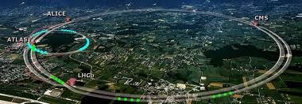
39: Particle Physics: Analysis of LHC Large Hadron Collider Data: Discovery of Higgs particle I
Astronomy & Physics
CERN LHC Accelerator Ring (27 km circumference. Up to 175m depth) at Geneva with 4 Experiment positions marked
Application: One analyses collisions at the CERN LHC (Large Hadron Collider) Accelerator and Monte Carlo producing events describing particle-apparatus interaction. Processed information defines physics properties of events (lists of particles with type and momenta). These events are analyzed to find new effects; both new particles (Higgs) and present evidence that conjectured particles (Supersymmetry) have not been detected. LHC has a few major experiments including ATLAS and CMS. These experiments have global participants (for example CMS has 3600 participants from 183 institutions in 38 countries), and so the data at all levels is transported and accessed across continents.
MRStat or PP, MC
Parallelism over observed collisions

Slide 67
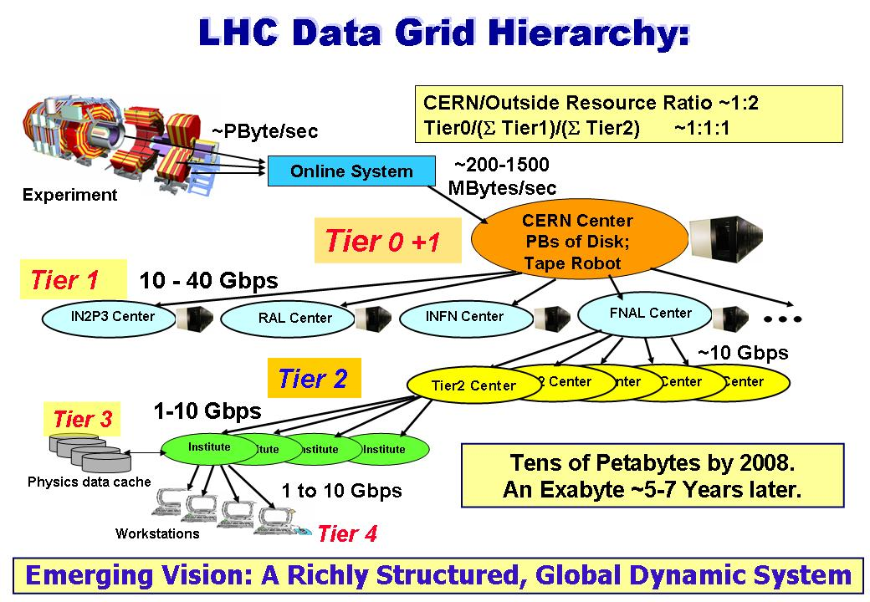
39: Particle Physics: Analysis of LHC Large Hadron Collider Data: Discovery of Higgs particle II
Astronomy & Physics
Current Approach: The LHC experiments are pioneers of a distributed Big Data science infrastructure, and several aspects of the LHC experiments’ workflow highlight issues that other disciplines will need to solve. These include automation of data distribution, high performance data transfer, and large-scale high-throughput computing. Grid analysis with 350,000 cores running “continuously” over 2 million jobs per day arranged in 3 tiers (CERN, “Continents/Countries”. “Universities”). Uses “Distributed High Throughput Computing” (Pleasing parallel) architecture with facilities integrated across the world by WLCG (LHC Computing Grid) and Open Science Grid in the US.
15 Petabytes data gathered each year from Accelerator data and Analysis with 200PB total. Specifically in 2012 ATLAS had at Brookhaven National Laboratory (BNL) 8PB Tier1 tape; BNL over 10PB Tier1 disk and US Tier2 centers 12PB disk cache. CMS has similar data sizes. Note over half resources used for Monte Carlo simulations as opposed to data analysis

Slide 68
39: Particle Physics: Analysis of LHC Large Hadron Collider Data: Discovery of Higgs particle III
Astronomy & Physics
Futures: In the past the particle physics community has been able to rely on industry to deliver exponential increases in performance per unit cost over time, as described by Moore's Law. However the available performance will be much more difficult to exploit in the future since technology limitations, in particular regarding power consumption, have led to profound changes in the architecture of modern CPU chips. In the past software could run unchanged on successive processor generations and achieve performance gains that follow Moore's Law thanks to the regular increase in clock rate that continued until 2006. The era of scaling HEP sequential applications is now over. Changes in CPU architectures imply significantly more software parallelism as well as exploitation of specialized floating point capabilities. The structure and performance of HEP data processing software needs to be changed such that it can continue to be adapted and further developed in order to run efficiently on new hardware. This represents a major paradigm-shift in HEP software design and implies large scale re-engineering of data structures and algorithms. Parallelism needs to be added at all levels at the same time, the event level, the algorithm level, and the sub-algorithm level. Components at all levels in the software stack need to interoperate and therefore the goal is to standardize as much as possible on basic design patterns and on the choice of a concurrency model. This will also help to ensure efficient and balanced use of resources.

Slide 69
40: Belle II High Energy Physics Experiment
Astronomy & Physics
Application: The Belle experiment is a particle physics experiment with more than 400 physicists and engineers investigating CP-violation effects with B meson production at the High Energy Accelerator KEKB e+ e- accelerator in Tsukuba, Japan. In particular look at numerous decay modes at the Upsilon(4S) resonance to search for new phenomena beyond the Standard Model of Particle Physics. This accelerator has the largest intensity of any in the world but events simpler than those from LHC and so analysis is less complicated but similar in style compared to the CERN accelerator.
Futures: An upgraded experiment Belle II and accelerator SuperKEKB will start operation in 2015 with a factor of 50 increased data with total integrated RAW data ~120PB and physics data ~15PB and ~100PB MC samples. Move to a distributed computing model requiring continuous RAW data transfer of ~20Gbps at designed luminosity between Japan and US. Will need Open Science Grid, Geant4, DIRAC, FTS, Belle II framework software.
MRStat or PP, MC
Parallelism over observed collisions

Slide 70
Introduction to NIST Big Data Public Working Group (NBD-PWG) Requirements and Use Case Subgroup Environment, Earth and Polar Science Use Cases

Slide 71
41: EISCAT 3D incoherent scatter radar system I
Earth, Environmental and Polar Science
Application: EISCAT, the European Incoherent Scatter Scientific Association, conducts research on the lower, middle and upper atmosphere and ionosphere using the incoherent scatter radar technique. This technique is the most powerful ground-based tool for these research applications. EISCAT studies instabilities in the ionosphere, as well as investigating the structure and dynamics of the middle atmosphere. It is also a diagnostic instrument in ionospheric modification experiments with addition of a separate Heating facility. Currently EISCAT operates 3 of the 10 major incoherent radar scattering instruments worldwide with its facilities in in the Scandinavian sector, north of the Arctic Circle.
Current Approach: The current running old EISCAT radar generates terabytes per year rates and does not present special challenges.
Futures: The design of the next generation radar, EISCAT_3D, will consist of a core site with a transmitting and receiving radar arrays and four sites with receiving antenna arrays at some 100 km from the core. The fully operational 5-site system will generate several thousand times data of current EISCAT system with 40 PB/year in 2022 and is expected to operate for 30 years. EISCAT 3D data e-Infrastructure plans to use the high performance computers for central site data processing and high throughput computers for mirror sites data processing. Downloading the full data is not time critical, but operations require real-time information about certain pre-defined events to be sent from the sites to the operation center and a real-time link from the operation center to the sites to set the mode of radar operation on with immediate action.
PP, GIS
Parallelism over Radar sensors leading to images

Slide 72
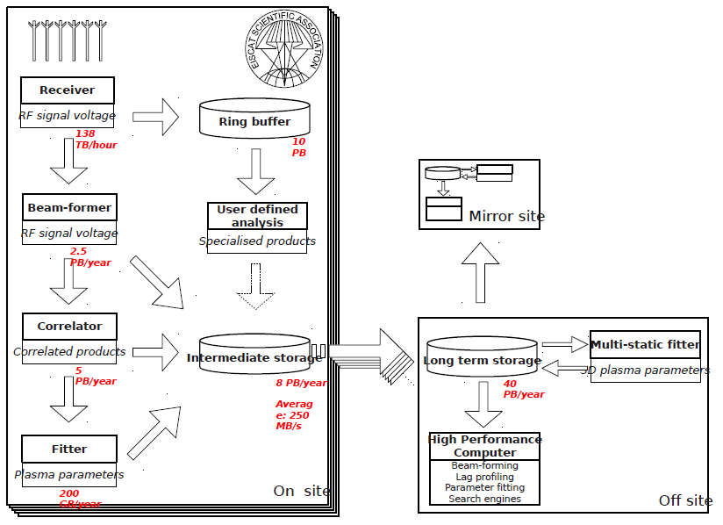
41: EISCAT 3D incoherent scatter radar system II
Earth, Environmental and Polar Science

Slide 73
(I) 42: ENVRI, Common Operations of Environmental Research Infrastructure
Earth, Environmental and Polar Science
Application: ENVRI Research Infrastructures (ENV RIs) addresses European distributed, long-term, remote controlled observational networks focused on understanding processes, trends, thresholds, interactions and feedbacks and increasing the predictive power to address future environmental challenges.
Current Approach: ENVRI develops a Reference Model (ENVRI RM) as a common ontological framework and standard for the description and characterization of computational and storage infrastructures in order to achieve seamless interoperability between the heterogeneous resources of different infrastructures. The ENVRI RM serves as a common language for community communication, providing a uniform framework into which the infrastructure’s components can be classified and compared, also serving to identify common solutions to common problems. Note data sizes in a given infrastructure vary from gigabytes to petabytes per year. There are 6 close and 2 loose couplings with big EU projects (next page)
Futures: ENVRI’s common environment will empower the users of the collaborating environmental research infrastructures and enable multidisciplinary scientists to access, study and correlate data from multiple domains for "system level" research. It provides Bigdata requirements coming from interdisciplinary research
Fusion, S/Q, Index, GIS
Streaming
Parallelism over Environmental observations including many sensors

Slide 74
(II) 42: ENVRI, Common Operations of Environmental Research Infrastructure
Earth, Environmental and Polar Science
ENVRI includes 6 major projects
ICOS is a European distributed infrastructure dedicated to the monitoring of greenhouse gases (GHG) through its atmospheric, ecosystem and ocean networks.
EURO-Argo is the European contribution to Argo, which is a global ocean observing system.
EISCAT-3D is a European new-generation incoherent-scatter research radar for upper atmospheric science. (see 41)
LifeWatch is an e-science Infrastructure for biodiversity and ecosystem research.
EPOS is a European Research Infrastructure on earthquakes, volcanoes, surface dynamics and tectonics.
EMSO is a European network of seafloor observatories for the long-term monitoring of environmental processes related to ecosystems, climate change and geo-hazards.
ENVRI also maintains close contact with the other not-directly involved ESFRI Environmental research infrastructures by inviting them for joint meetings. These projects are:
IAGOS Aircraft for global observing system
SIOS Svalbard arctic Earth observing system

Slide 75
(III) 42: ENVRI, Common Operations of Environmental Research Infrastructure
Earth, Environmental and Polar Science
Data acquisition: collects raw data from sensor arrays, various instruments, or human observers, and brings the measurements (data streams) into the system.
Data curation: facilitates quality control and preservation of scientific data. It is typically operated at a data center.
Data access: enables discovery and retrieval of data housed in data resources managed by a data curation subsystem.
Data processing: aggregates the data from various resources and provides computational capabilities and capacities for conducting data analysis and scientific experiments.
Community support: manages, controls and tracks users' activities and supports users to conduct their roles in communities.
ENVRI Common Architecture
http://www.envri.eu/rm

Slide 76
(IV) 42: ENVRI, Common Operations of Environmental Research Infrastructure
Earth, Environmental and Polar Science
ICOS Architecture for the monitoring of greenhouse gases (GHG) through its atmospheric, ecosystem and ocean networks

Slide 77
(V) 42: ENVRI, Common Operations of Environmental Research Infrastructure
Earth, Environmental and Polar Science
LifeWatch Architecture
e-science Infrastructure for biodiversity and ecosystem research
See project 25

Slide 78
(VI) 42: ENVRI, Common Operations of Environmental Research Infrastructure
Earth, Environmental and Polar Science
EMSO Architecture
European network of seafloor observatories for the long-term monitoring of environmental processes related to ecosystems, climate change and geo-hazards.

Slide 79
(VII) 42: ENVRI, Common Operations of Environmental Research Infrastructure
Earth, Environmental and Polar Science
Eura-Argo Architecture
Global ocean observing system.

Slide 80
43: Radar Data Analysis for CReSIS Remote Sensing of Ice Sheets I
Earth, Environmental and Polar Science
Application: This data feeds into intergovernmental Panel on Climate Change (IPCC) and uses custom radars to measures ice sheet bed depths and (annual) snow layers at the North and South poles and mountainous regions.
Current Approach: The initial analysis is currently Matlab signal processing that produces a set of radar images. These cannot be transported from field over Internet and are typically copied to removable few TB disks in the field and flown “home” for detailed analysis. Image understanding tools with some human oversight find the image features (layers) shown later, that are stored in a database front-ended by a Geographical Information System. The ice sheet bed depths are used in simulations of glacier flow. The data is taken in “field trips” that each currently gather 50-100 TB of data over a few week period.
Futures: An order of magnitude more data (petabyte per mission) is projected with improved instrumentation. Demands of processing increasing field data in an environment with more data but still constrained power budget, suggests low power/performance architectures such as GPU systems.
PP, GIS
Streaming
Parallelism over Radar Images

Slide 81
43: Radar Data Analysis for CReSIS Remote Sensing of Ice Sheets II
Earth, Environmental and Polar Science
Typical CReSIS data showing aircraft taking data which shows a glacier bed at a depth of 3100 meters with multiple confusing reflections.

Slide 82
43: Radar Data Analysis for CReSIS Remote Sensing of Ice Sheets III
Earth, Environmental and Polar Science
Typical flight paths of CReSIS data gathering in survey region

Slide 83
43: Radar Data Analysis for CReSIS Remote Sensing of Ice Sheets IV
Earth, Environmental and Polar Science
Typical CReSIS echogram with Detected Boundaries. The upper (green) boundary is between air and ice layer while the lower (red) boundary is between ice and terrain

Slide 84
44: UAVSAR Data Processing, Data Product Delivery, and Data Services I
Earth, Environmental and Polar Science
Application: Synthetic Aperture Radar (SAR) can identify landscape changes caused by seismic activity, landslides, deforestation, vegetation changes and flooding. This is for example used to support earthquake science (see next slide) as well as disaster management. This use case supports the storage, application of image processing and visualization of this geo-located data with angular specification.
Current Approach: Data from planes and satellites is processed on NASA computers before being stored after substantial data communication. The data is made public as soon as processed and requires significant curation due to instrumental glitches. The current data size is ~150TB
Futures: The data size would increase dramatically if Earth Radar Mission launched. Clouds are suitable hosts but are not used today in production.
PP, GIS
Streaming
Parallelism over Radar Images

Slide 85
44: UAVSAR Data Processing, Data Product Delivery, and Data Services II
Earth, Environmental and Polar Science
Combined unwrapped coseismic interferograms for flight lines 26501, 26505, and 08508 for the October 2009 – April 2010 time period. End points where slip can be seen on the Imperial, Superstition Hills, and Elmore Ranch faults are noted. GPS stations are marked by dots and are labeled.

Slide 86
45: NASA LARC/GSFC iRODS Federation Testbed
Earth, Environmental and Polar Science
Application: NASA Center for Climate Simulation (NCCS) and NASA Atmospheric Science Data Center (ASDC) have complementary data sets, each containing vast amounts of data that is not easily shared and queried. Climate researchers, weather forecasters, instrument teams, and other scientists need to access data from across multiple datasets in order to compare sensor measurements from various instruments, compare sensor measurements to model outputs, calibrate instruments, look for correlations across multiple parameters, etc.
Current Approach: The data includes MERRA (Project 46) and NASA Clouds and Earth's Radiant Energy System (CERES) EBAF(Energy Balanced And Filled)-TOA(Top of Atmosphere) Product which is about 420MB and Data from the EBAF-Surface Product which is about 690MB. Data grows with each version update (about every six months).
To analyze, visualize and otherwise process data from heterogeneous datasets is currently a time consuming effort that requires scientists to separately access, search for, and download data from multiple servers and often the data is duplicated without an understanding of the authoritative source. Often times accessing data is greater than scientific analysis time. Current datasets are hosted on modest size (144 to 576 cores) Infiniband clusters.
Futures: The improved access will be enabled through the use of iRODS that enables parallel downloads of datasets from selected replica servers that can be geographically dispersed, but still accessible by users worldwide. iRODS operation will be enhanced with semantically organized metadata, and managed via a highly precise Earth Science ontology. Cloud solutions will also be explored.
S/Q, Index, GIS
Streaming
Parallelism over Datasets

Slide 87
46: MERRA Analytic Services MERRA/AS
Earth, Environmental and Polar Science
Application: This application produces global temporally and spatially consistent syntheses of 26 key climate variables by combining numerical simulations with observational data. Three-dimensional results are produced every 6-hours extending from 1979-present.
This supports important applications like Intergovernmental Panel on Climate Change (IPCC) research and the NASA/Department of Interior RECOVER wildfire decision support system; these applications typically involve integration of MERRA with other datasets.
Current Approach: MapReduce is used to process a current total of 480TB. The current system is hosted on a 36 node Infiniband cluster
Futures: Clouds are being investigated. The data is growing by one TB a month.
MR, GIS
Typical MERRA/AS Output
Streaming
Parallelism over Observation and Simulation results on climate assimilated

Slide 88
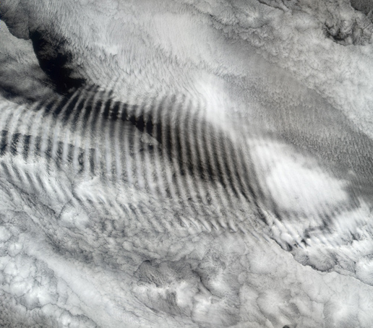
47: Atmospheric Turbulence - Event Discovery and Predictive Analytics
Earth, Environmental and Polar Science
Application: This builds datamining on top of reanalysis products including the North American Regional Reanalysis (NARR) and the Modern-Era Retrospective-Analysis for Research (MERRA) from NASA where latter described earlier. The analytics correlate aircraft reports of turbulence (either from pilot reports or from automated aircraft measurements of eddy dissipation rates) with recently completed atmospheric re-analyses. This is of value to aviation industry and to weather forecasters. There are no standards for re-analysis products complicating system where MapReduce is being investigated. The reanalysis data is hundreds of terabytes and slowly updated whereas turbulence is smaller in size and implemented as a streaming service.
Current Approach: Current 200TB dataset can be analyzed with MapReduce or the like using SciDB or other scientific database.
Futures: The dataset will reach 500TB in 5 years. The initial turbulence case can be extended to other ocean/atmosphere phenomena but the analytics would be different in each case.
Typical NASA image of turbulent waves
Local ML, GIS, Classification
Streaming
Parallelism over Images and atmospheric events/parameters

Slide 89
48: Climate Studies using the Community Earth System Model at DOE’s NERSC center
Earth, Environmental and Polar Science
Application: We need to understand and quantify contributions of natural and anthropogenic-induced patterns of climate variability and change in the 20th and 21st centuries by means of simulations with the Community Earth System Model (CESM). The results of supercomputer simulations across the world need to be stored and compared.
Current Approach: The Earth Systems Grid (ESG) enables world wide access to Peta/Exa-scale climate science data with multiple petabytes of data at dozens of federated sites worldwide. The ESG is recognized as the leading infrastructure for the management and access of large distributed data volumes for climate change research. It supports the Coupled Model Intercomparison Project (CMIP), whose protocols enable the periodic assessments carried out by the Intergovernmental Panel on Climate Change (IPCC).
Futures: Rapid growth of data with 30 PB produced at NERSC (assuming 15 end-to-end climate change experiments) in 2017 and many times more this worldwide
HPC simulations, MR for assimilation as in 46, GIS
Streaming
Parallelism over Standard simulation parallelism; observed climate data

Slide 90
49: DOE-BER Subsurface Biogeochemistry Scientific Focus Area
Earth, Environmental and Polar Science
Application: Development of a Genome-Enabled Watershed Simulation Capability (GEWaSC) that will provide a predictive framework for understanding how genomic information stored in a subsurface microbiome, affects biogeochemical watershed functioning; how watershed-scale processes affect microbial functioning; and how these interactions co-evolve.
Current Approach: Current modeling capabilities can represent processes occurring over an impressive range of scales (ranging from a single bacterial cell to that of a contaminant plume). Data crosses all scales from genomics of the microbes in the soil to watershed hydro-biogeochemistry. Data are generated by the different research areas and include simulation data, field data (hydrological, geochemical, geophysical), ‘omics data, and observations from laboratory experiments.
Futures: : Little effort to date has been devoted to developing a framework for systematically connecting scales, as is needed to identify key controls and to simulate important feedbacks. GEWaSC will develop a simulation framework that formally scales from genomes to watersheds and will synthesize diverse and disparate field, laboratory, and simulation datasets across different semantic, spatial, and temporal scales.
Fusion, HPC Simulations, GIS
Streaming
Parallelism over Sensors, Sequences, standard simulation parallelism

Slide 91
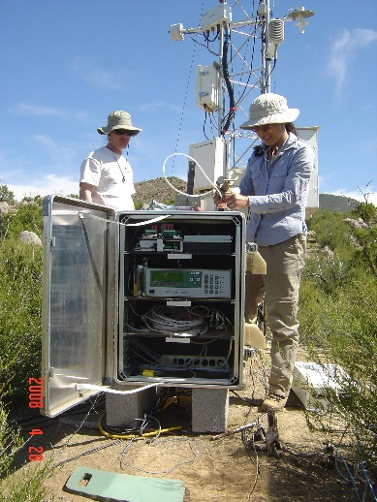
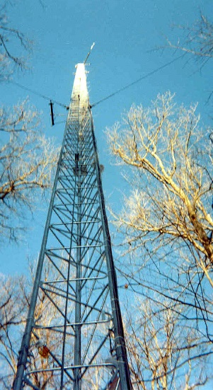
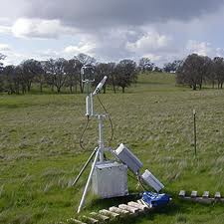
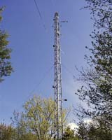
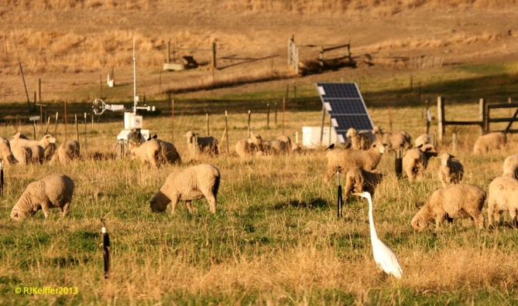
50: DOE-BER AmeriFlux and FLUXNET Networks I
Earth, Environmental and Polar Science
Application: AmeriFlux and FLUXNET are US and world collections respectively of sensors that observe trace gas fluxes (CO2, water vapor) across a broad spectrum of times (hours, days, seasons, years, and decades) and space. Moreover, such datasets provide the crucial linkages among organisms, ecosystems, and process-scale studies—at climate-relevant scales of landscapes, regions, and continents—for incorporation into biogeochemical and climate models.
Current Approach: Software includes EddyPro, Custom analysis software, R, python, neural networks, Matlab. There are ~150 towers in AmeriFlux and over 500 towers distributed globally collecting flux measurements.
Futures: Field experiment data taking would be improved by access to existing data and automated entry of new data via mobile devices. Need to support interdisciplinary study integrating diverse data sources.

Slide 92
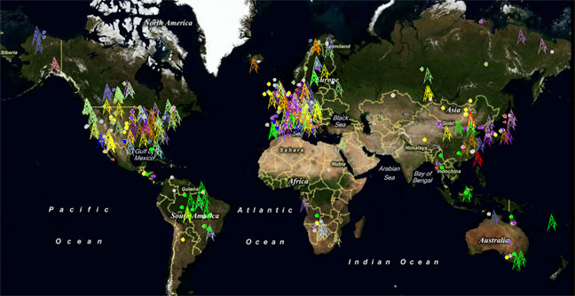
50: DOE-BER AmeriFlux and FLUXNET Networks II
Earth, Environmental and Polar Science
FLUXNET datasets consist of over 960 site-years of data from over 253 eddy covariance measurement sites
Fusion, PP, GIS
Streaming
Parallelism over Sensors

Slide 93
Introduction to NIST Big Data Public Working Group (NBD-PWG) Requirements and Use Case Subgroup Energy Use Case

Slide 94
51: Consumption forecasting in Smart Grids
Energy
Application: Predict energy consumption for customers, transformers, sub-stations and the electrical grid service area using smart meters providing measurements every 15-mins at the granularity of individual consumers within the service area of smart power utilities. Combine Head-end of smart meters (distributed), Utility databases (Customer Information, Network topology; centralized), US Census data (distributed), NOAA weather data (distributed), Micro-grid building information system (centralized), Micro-grid sensor network (distributed). This generalizes to real-time data-driven analytics for time series from cyber physical systems
Current Approach: GIS based visualization. Data is around 4 TB a year for a city with 1.4M sensors in Los Angeles. Uses R/Matlab, Weka, Hadoop software. Significant privacy issues requiring anonymization by aggregation. Combine real time and historic data with machine learning for predicting consumption.
Futures: Wide spread deployment of Smart Grids with new analytics integrating diverse data and supporting curtailment requests. Mobile applications for client interactions.
Fusion, PP, MR, ML, GIS, Classification
Streaming
Parallelism over Sensors

Slide 95
Introduction to NIST Big Data Public Working Group (NBD-PWG) Requirements and Use Case Subgroup Summary of Use Case Classification

Slide 96
What is Parallelism Over?
People: either the users (but see below) or subjects of application and often both
Decision makers like researchers or doctors (users of application)
Items such as Images, EMR, Sequences below; observations or contents of online store
Images or “Electronic Information nuggets”
EMR: Electronic Medical Records (often similar to people parallelism)
Protein or Gene Sequences;
Material properties, Manufactured Object specifications etc. in custom dataset
Modelled entities like vehicles and people
Sensors – Internet of Things
Events such as detected anomalies in telescope or credit card data or atmosphere
(Complex) Nodes in RDF Graph
Simple nodes as in a learning network
Tweets, Blogs, Documents, Web Pages etc.
And characters/words in them
Files or data to be backed up, moved or assigned metadata
Particles/cells/mesh points as in parallel simulations

Slide 97
Low-Level (Run-time) Computational Types
PP(8): Pleasingly Parallel or Map Only
MR(16 +7 MRStat): Classic MapReduce
MRStat(7): Simple version of MR where key computations are simple reduction as coming in statistical averages
MRIter(19): Iterative MapReduce
Graph(4): complex graph data structure needed in analysis
Fusion(8): Integrate diverse data to aid discovery/decision making; could involve sophisticated algorithms or could just be a portal
MC(2): Monte Carlo simulations of data system for quantifying analysis
Streaming(34): some data comes in incrementally and processed this way

Slide 98
High-Level Computational Types or Features
Classification(20): divide data into categories
S/Q(12): Search and Query
Index(12): Find indices to enable fast search
CF(4): Collaborative Filtering
ML(5): Machine Learning and sophisticated statistics: Clustering, LDA, SVM …
Divide into largely local or executed independently for each “item” or global if involve simultaneous variation of features of many(all) items
Typically implied by classification and EGO but details not always available
EGO(6): Large Scale Optimizations (Exascale Global Optimization) as in Variational Bayes, Lifted Belief Propagation, Stochastic Gradient Descent, L-BFGS, MDS, Global Machine Learning (see above)
EM(not listed in descriptions): Expectation maximization (often implied by ML and used in EGO solution); implies iterative
GIS(16): Geotagged data and often displayed in ESRI, Google Earth etc.
HPC(4): Classic large scale simulation of cosmos, materials etc.
Agent(2): Simulations of models of macroscopic entities represented as agents

Slide 99
Big Data Kernels/Patterns/Dwarves: Overall Structure
Use cases in (); sometimes not enough detail for dwarf assignment
Classic Database application as in NARA (1-5)
Database built (in future) on top of NoSQL such as Hbase for media (6-8), Search (8), Health (16, 21, 22), AI (26, 27), or Network Science (28) followed by analytics
Basic processing of data as in backup or metadata (9, 32, 33, 45)
GIS support of spatial big data (13-15, 25, 41-51)
Host of Sensors processed on demand (10, 14-15, 25, 42, 49-51)
Pleasingly parallel processing (varying from simple to complex for each observation and including local ML) of items such as experimental observations (followed by a variety of global follow-on stages) (19, 20, 39, 40, 41, 42) with images common (17, 18, 35-38, 43, 44, 47)
HPC assimilated with observational data (11, 12, 37, 46, 48, 49)
Big data driving agent-based models (23, 24)
Multi-modal data fusion or Knowledge Management for discovery and decision support (15, 37, 49-51)
Crowd Sourcing as “key algorithm” (29)

Slide 100
Big Data Kernels/Patterns/Dwarves: Global Analytics
Note some of use cases don’t give enough detail to pinpoint analytics
Accumulation of document style data followed by some sort of classification algorithm such as LDA (6, 31, 33, 34)
EGO (26, 27)
Recommender system such as collaborative filtering (3, 4, 7)
Learning neural networks (26, 31)
Graph algorithms (21, 24, 28, 30)
Global machine learning such as clustering or SVM O(N) in data size (17, 31, 38)
Global machine learning such as MDS O(N²) in data size (28, 31)

Slide 101
Introduction to NIST Big Data Public Working Group (NBD-PWG) Requirements and Use Case Subgroup Database Use Case Classification

Slide 102
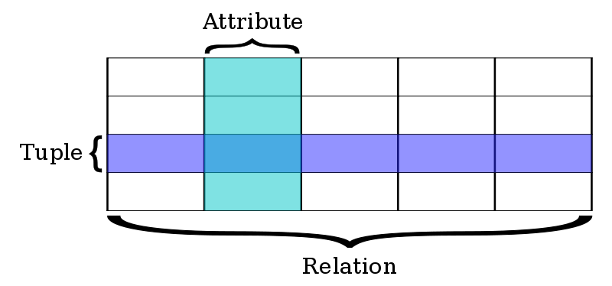
Classic Database application
Now we discuss approaches to important Search&Query and Index features
Built around predetermined table structures (“Schema-on-write”) with highly optimized queries in SQL language
OLTP Online Transaction Processing as done for bank accounts is a good example where traditional (relational) databases good.
Very good indices for quick query response
Fault tolerance done very well
This can be scaled to large systems but parallelism is not easy – partly due to robustness constraints.
Note bank accounts involve little computing and data is “only” large
100 million people at ten megabytes of data (10⁵ transactions of 100 bytes) is a petabyte

Slide 103
Classic Database application
There is a vigorous debate as to which is better
Databases or new cloud solutions typified by Hadoop for processing and NoSQL for storage?
Modern data analytics are not helped significantly by RDBMS (Relational Database management System) technologies and can run on cheaper hardware that can scale to much larger datasets than RDBMS
SQL does not have built in clustering or recommender systems!
The RDBMS optimizations (which are great for OLTP) come at a cost so that price per terabyte per year is $1000-$2000 for a Hadoop cluster but 5-10 or more times that for a commercial RDBMS installation
RDBMS needs more expensive servers whereas Hadoop scales on cheap commodity hardware.
Commercial RDBMS software very expensive
ETL (Extract, Transform Load) and “Data Warehouse” are important terms in describing RDBMS approach to diverse unstructured data
Also operational data store or ODS

Slide 104
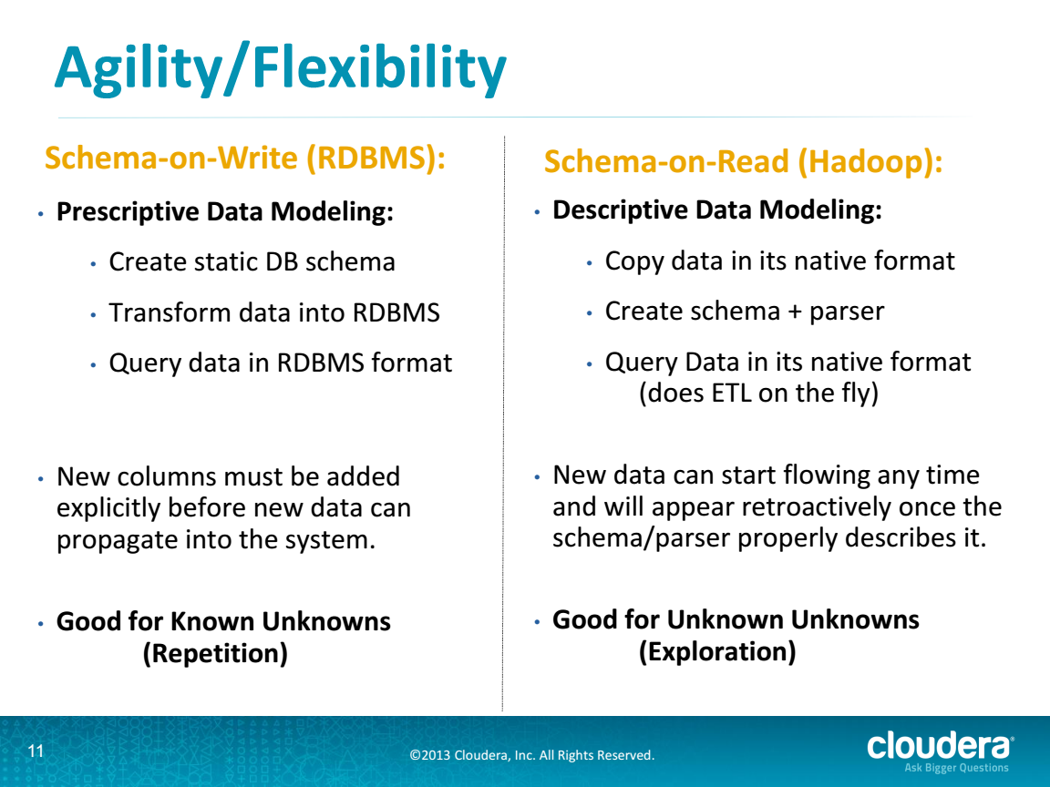
RDBMS v. Cloud from Cloudera
http://cci.drexel.edu/bigdata/bigdata2013/Apache%20Hadoop%20in%20the%20Enterprise.pdf

Slide 105
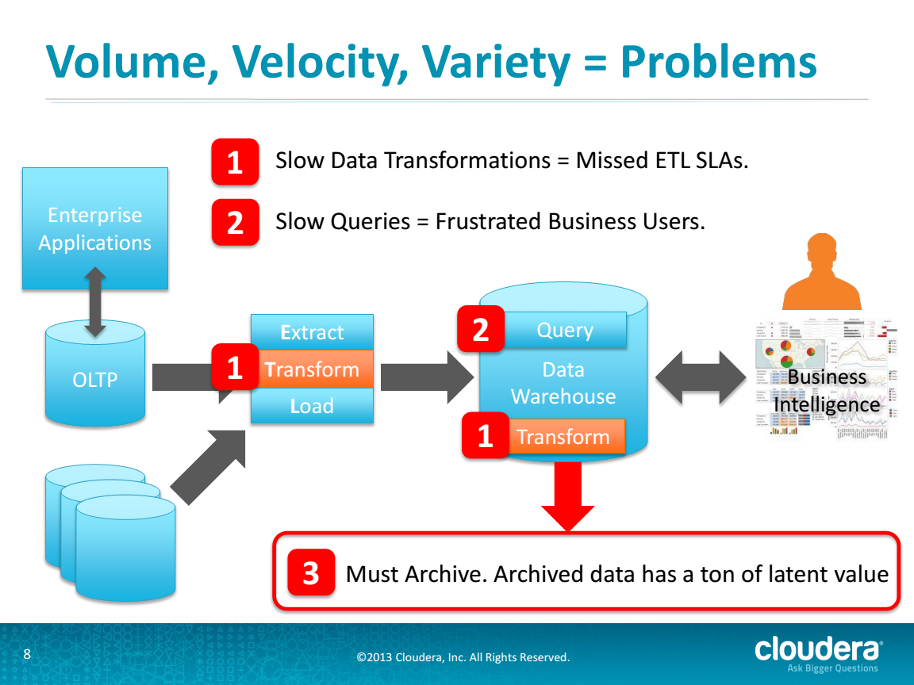
Problems in RDBMS Approach
http://cci.drexel.edu/bigdata/bigdata2013/Apache%20Hadoop%20in%20the%20Enterprise.pdf

Slide 106
Traditional Relational Database Approach
ETL = Extract, Transform, Load
20120119berkeley.pdf Jeff Hammerbacher

Slide 107
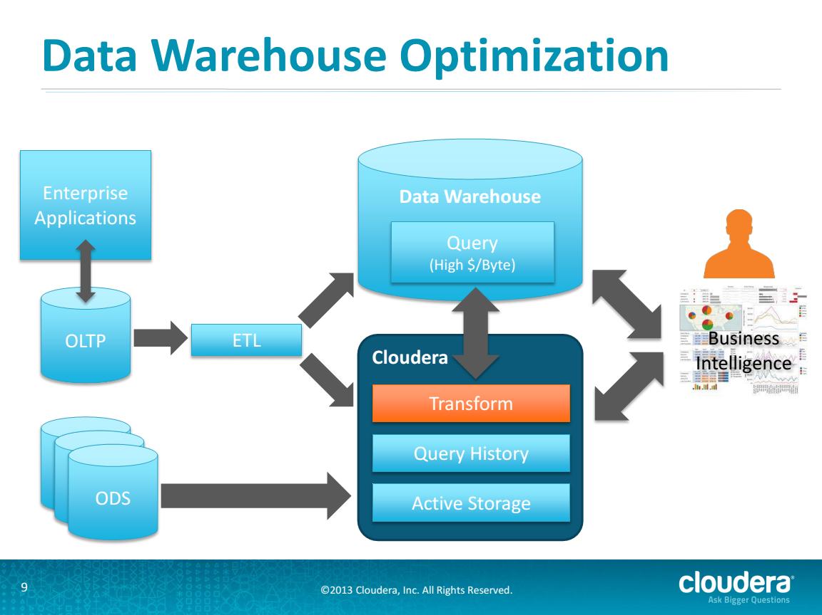
Hybrid RDBMS Cloud Solution from Cloudera
http://cci.drexel.edu/bigdata/bigdata2013/Apache%20Hadoop%20in%20the%20Enterprise.pdf

Slide 108
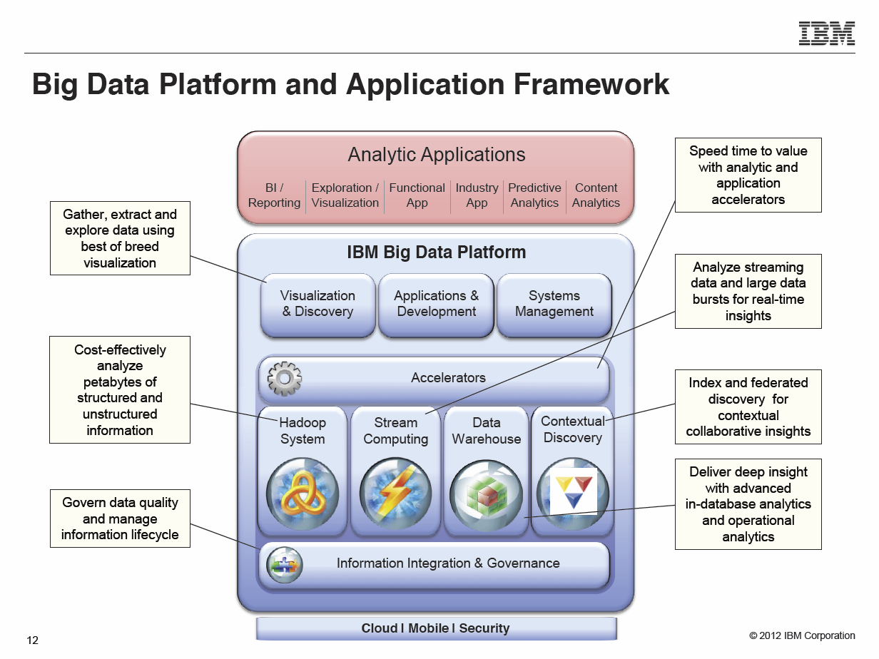
Typical Modern Do-everything Solution from IBM
Anjul Bhambhri, VP of Big Data, IBM http://fisheritcenter.haas.berkeley.edu/Big_Data/index.html

Slide 109
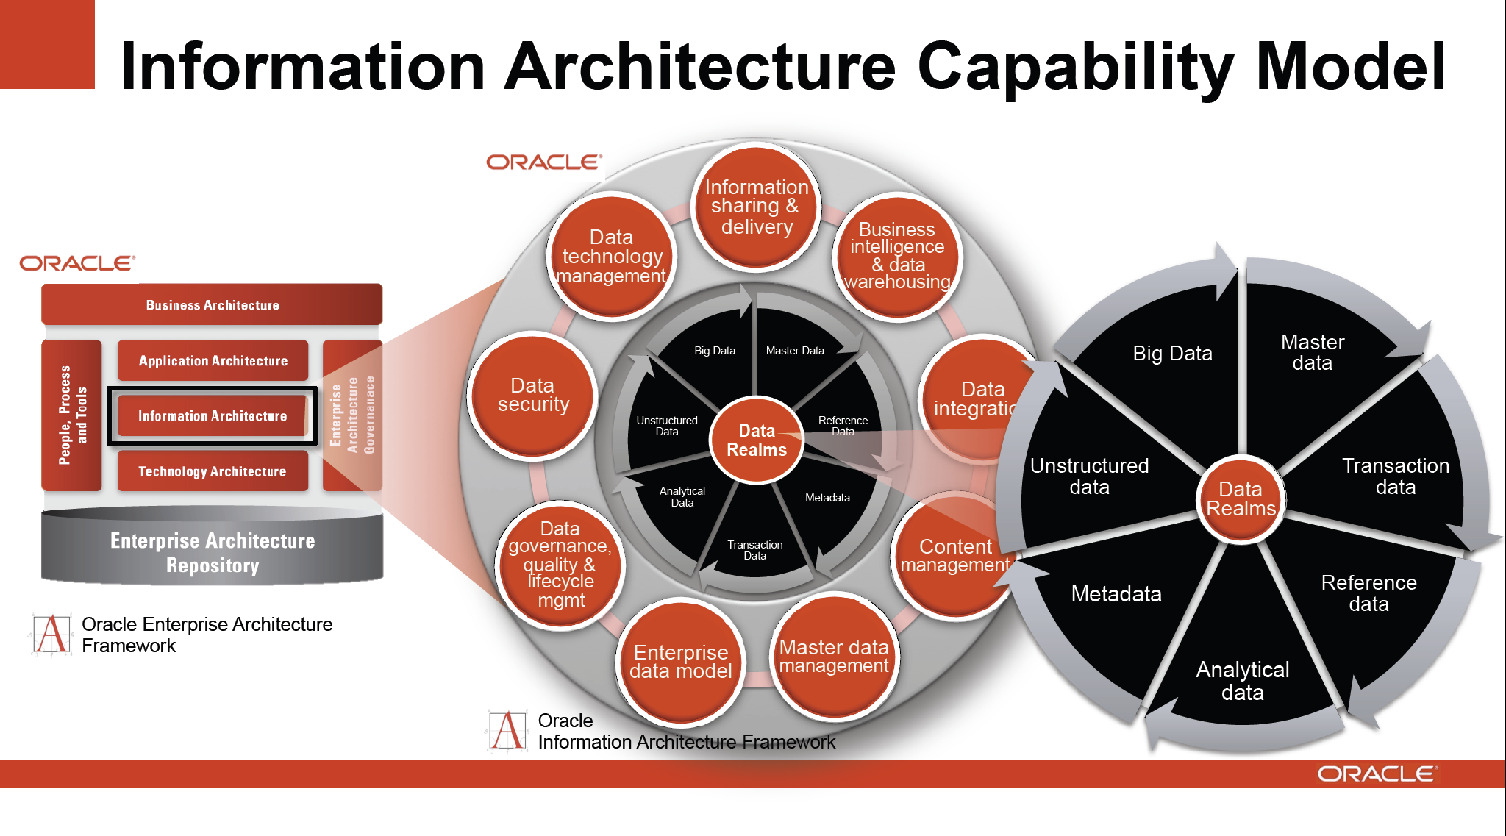
Typical Modern Do-everything Solution from Oracle
http://cs.metrostate.edu/~sbd/ Oracle

Slide 110
Introduction to NIST Big Data Public Working Group (NBD-PWG) Requirements and Use Case Subgroup NoSQL Use Case Classification

Slide 111
Database built on top of NoSQL such as Hbase for media I
The “cloud” solution for databases or data systems was originally developed by the Internet companies – Google and Yahoo for search and Amazon, eBay for commerce, who needed cheaper faster solutions than relational databases.
They were driven by the commercial cloud infrastructure companies pioneered and still dominated by Amazon which made it easy for new startups (as large as Netflix) to outsource their computing flexibly
Hadoop (developed at Yahoo on MapReduce model from Google) was an important driver as MapReduce turned out to be easy to use, powerful and free.
Hadoop was developed by Apache open source process and grew many related projects forming the Apache Big Data Stack – many of them contained in Apache Bigtop project.
Cloudera was a company whose business model involves supporting and enhancing Apache big data stack

Slide 112
Database built on top of NoSQL such as Hbase for media II
One important part of Hadoop ecosystem is Hbase which is the open source version of Bigtable which was the original Google data management system built to support distributed tables
Hbase is built on HDFS – the Hadoop File System – which correspondingly is open source version of GFS – the Google File System
Key feature is data distributed over same nodes that do computing
Builds in “Bring computing to the Data” Big data principle
HDFS/Hbase is equivalent of stored data in relational database
Hadoop MapReduce is equivalent of SQL processing engine although it uses Java not SQL to express processing
Hadoop runs several maps in parallel in so-called SPMD (single program multiple data) mode – each map processes a part of the data
The Reduce step integrates the results from all maps to get full answer.

Slide 113
Apache Big data Stack

Slide 114
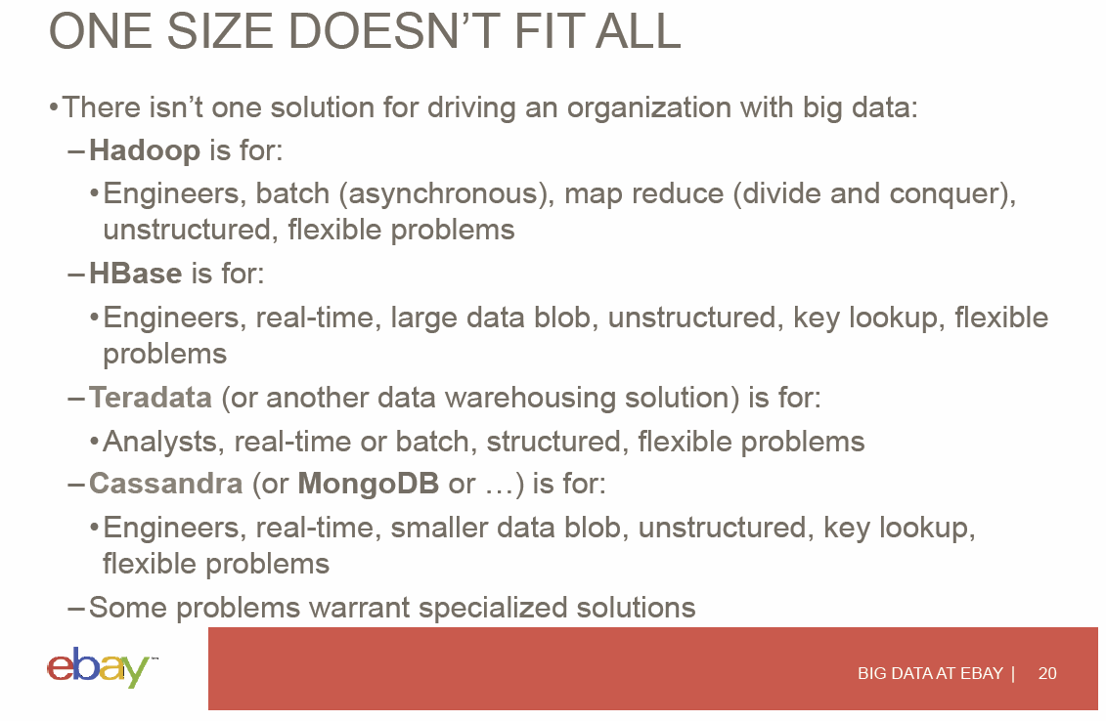
View from eBay on Trade-offs
Hugh Williams
http://fisheritcenter.haas.berkeley.edu/Big_Data/index.html

Slide 115
Introduction to NIST Big Data Public Working Group (NBD-PWG) Requirements and Use Case Subgroup Use Case Classifications I

Slide 116
GIS support of spatial big data
Many use cases are involved with entities that are functions of space and time; in particular use cases from defense, earth, environmental, polar science are strongly correlated to position
Some Physics and most Astronomy use cases can also have this feature
Note use cases 43 and 44 have map-based illustrations.
Fundamental physics use case 39 is not like this – partly as quantum mechanics makes traditional pictures misleading but physics often uses non map based 3D simulations.
A GIS – Geographical Information System – is designed to display spatial (“geo-located) data with information added or available as you browse via clicking; Google Earth and maps are familiar GIS and ESRI
The Open Geospatial Consortium has set standards and methodology to allow different owners of geolocated material present their wares so can be placed on same GIS display

Slide 117
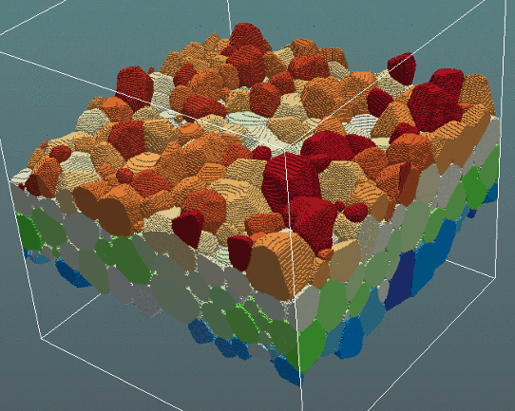
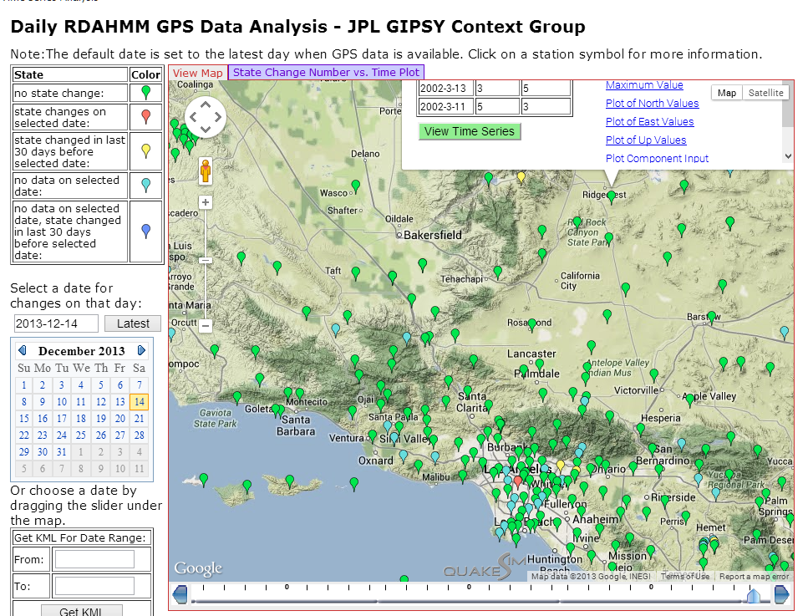
3D (4D with time) science has special displays or visualizations
3D view of a grain structure in a nanomaterial (use cases 11,12) http://www.icams.de/content/departments/stks/index.html
GIS of GPS sensors monitored at JPL http://www.quakesim.org/tools/timeseries for earthquake signatures
with one GPS clicked near top right to get more information

Slide 118
Host of Sensors processed on demand
Sensors are typically small and well served by a single virtual machine in the cloud (in fact share with many other sensors)
Cloud records data, controls and acts as a source of intelligence for sensors (perform hard calculation, access web)
It is projected that there will be 24-75 billion devices on the Internet by 2020

Slide 119

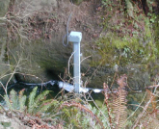
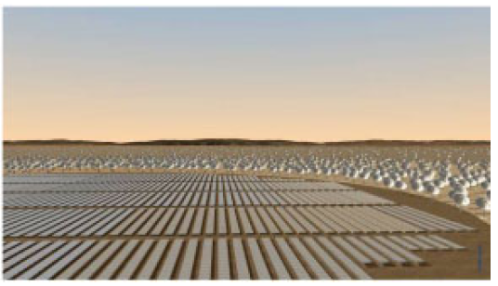
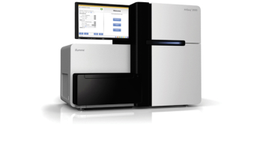
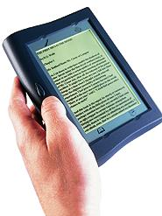

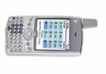
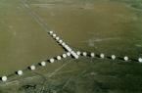


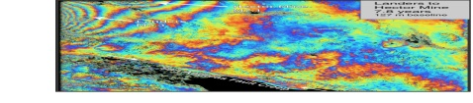
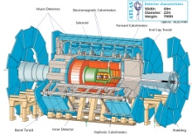
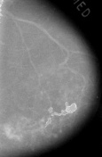
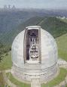
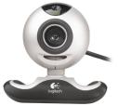
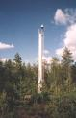
Raw Data → Data → Information → Knowledge → Wisdom → Decisions
Another Grid
SS
SS
SS
SS
SS
SS
SS
Filter Cloud
Discovery Cloud
Portal
Filter Cloud
Fusion for Discovery/Decisions
SS
Filter Cloud
Another Service
SS
Filter Cloud
Filter Cloud
Filter Cloud
Discovery Cloud
SS
SS: Sensor or Data
Interchange
Service
Workflow through multiple filter/discovery clouds or Services
SS
Filter Cloud
Filter Cloud
Filter Cloud
Filter Cloud
SS
Another Cloud
SS
SS
SS
SS
SS
SS
SS
SS
SS
SS
SS
SS
SS
Compute Cloud
Storage Cloud
Distributed Grid
Hadoop Cluster
Database

Slide 120
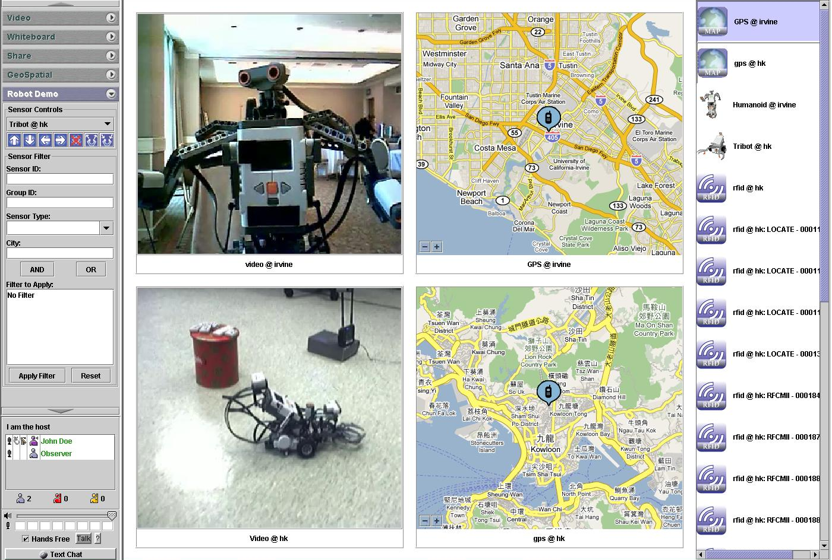
Sensor Control Interface with GIS and Information Fusion

Slide 121
Introduction to NIST Big Data Public Working Group (NBD-PWG) Requirements and Use Case Subgroup Use Case Classifications II

Slide 122
Pleasingly Parallel Processing
This is a simple but incredibly important class of parallel computing problem.
Parallel computing involves organizing a set of computers to solve a given problem and one major task is organizing the separate computers so they are working together. In pleasingly parallel mode this task is at its simplest as different computers can work independently
One example is the LHC particle physics analysis where several billion collision events (each of about 1.5 megabytes size for 2 largest experiments) are recorded each year. A major step in analysis is converting the raw data for each event into lists of produced particles and this takes about 10 seconds per core.
Each of the many billion computations are independent and so this problem is pleasingly parallel.
Actually there are several other correlated activities which in this case involve various global reductions such as forming averages for calibration and histograms for physics (see this section of class). We capture this as MRStat category.
Different users accessing a database or different sensors accessing cloud are other pleasing parallel use cases.

Slide 123
More on Overall Structure
Data Assimilation: Several of use cases involve the combination of observational data and HPC (High Performance Computing) simulations
This enables comparison of observation with a theoretical simulation
In some fields such as weather/climate, simulations are inevitably uncertain (as the atmosphere is not precisely understood for say chemical composition) and assimilation combines data and simulation to produce more reliable forecasts
Crowd Sourcing: this is typified by Amazon Mechanical Turk and corresponds to aggregation of work of many people to solve big data issues.
People can do some image processing problems better than computers
They can supply missing or correct existing data to add to knowledge as in Wikipedia
There are a lot of people so crowd sourcing is a big data strategy
Crowd sourcing is particularly relevant in use cases like 29 that study people

Slide 124
Agent-based modelling:
When one simulates a new material one typically uses fundamental equations of matter describing atoms, electrons, molecules. However if we want to simulate the stock market, transportation systems or reaction of population to disease or shock, then the basic entities are not fundamental quantities
Rather people, cars, stocks are “macroscopic quantities” defined not by Newton’s laws but by some set of interaction or time evolution “empirical” rules. They form complex systems
One uses Agents which are black boxes with defined responses to other agents and rest of context for this type of simulation
Agents are sometimes evolved with slow event driven simulations but the methods used in use cases 23 and 24 are much faster although agent simulations are always slower (per entity) than simple fundamental particle simulations

Slide 125
Data Fusion and Workflow
Data fusion and related areas like “knowledge management” are well used phrases with an intuitively clear meaning but with no clear technical definition.
Almost all areas have multiple types and sources of data and integrating these together is important
Raw Data → Data → Information → Knowledge → Wisdom → Decisions slide show a workflow with multiple services/clouds linked together in a data flow fashion to finally present results fused together in portal
The fusion can be as simple as placing results of analysis of different types of data in different parts of the portal so a decision maker can weigh the different results
Alternatively a clever machine learning algorithm can integrate the different pieces of information and reach a conclusion
This is like χ² discussion in EGO

Slide 126
Exascale Global Optimization EGO
EGO is used to represent an artificial intelligence (AI) problem phrased as a giant optimization over many variables
The simplest case is χ² or similar Maximum likelihood formulations which end as minimization of a sum of terms which involve observational data and parameters to be determined
This analytic formulation of AI is rather different from traditional rule based or expert system AI
Its easy enough to minimize the sum of a billion terms but not so easy to reliably apply a billion rules
One example we will discuss later in course is Multi-dimensional scaling where for N entities (say sequences) one has N(N-1)/2 measures of similarities between pairs and one minimizes weighted sum of square of similarities minus predicted similarities from an assignment of entity to a position in some vector space.
Information retrieval takes the world’s documents and finds best possible set of topics implied by them

Slide 127
Security
Security is a critical feature that applies to essentially all datasets and use cases and was discussed earlier as it was a NIST WG
It covers
Authentication & Authorization
Privacy issues in use of confidential data either because its proprietary or because its personal
Problems with tampering with any component of dta system from sensors recording data to computers doing calculations
Special issues with clouds which as a shared resource enhance most security problems – for example one can spy on one program or dataset from another cloud program that seems legitimate
Security is seen directly in use cases especially in
Commercial applications as proprietary issues
Defense due to National security
Health and social studies as personal information

Slide 128
Classification
Many big data use cases involve classifying data in some fashion
Search classifies documents by their nearness to your search
Recommender systems classify items by their relevance to your interests
Network science divide people and the Internet into communities of like-minded folks
Biologists classify sequences by their role and the family to which they belong
Classification is implemented by Machine Learning ML in several ways
SVM divides data into regions by planes
Clustering divides data into groups where members of each group are near each other
Clustering is “unsupervised” learning as no input as to categories
Collaborative Filtering CF is supervised as use existing rankings to predict new rankings
Learning networks train with existing classifications to be able to predict new ones and so are typically supervised (although use case 26 has both)

Slide 129
Other Features identified in Use Case analysis
We have discussed PP, Fusion, EGO, HPC, GIS, Agent, S/Q, Index, Classification
MC stands for Monte Carlo and corresponds to generation of random data that mimics observed data. It is used to quantify analysis by testing methods and determining their efficiency
In particle physics use cases 39, 40 the volume of data and compute needs associated with Monte Carlo events is comparable to data for observed events
Many applications have data added incrementally and processing such streaming data involves different algorithms from batch approach to a large existing dataset. This is Streaming and supported by new Apache projects Storm, S4 and Samza
Note in use cases like 39 data is not added one event at a time but rather in “runs” as issues of calibration imply that data taken under certain conditions should be analyzed at same time as other data from same run. This is NOT Streaming

Slide 130
Classifying Use Case Programming Model I
PP, MR, MRStat, MRIter and HPC(MPI)
These categories are illustrated as runtime structure on following slide using SPMD Single Program Multiple Data structure
Always parallelism comes from dividing up something that’s big (typically main dataset) and using lots of processes (cores) each process tackling part of problem.
We listed sources of parallelism for each use case earlier
The calculation done by each process is called a Map and the communication between processes required for total answer is called Reduce.
No reductions or Map Only is Pleasingly Parallel PP
Classic MapReduce MR has one set of Maps followed by one Reduction
MRStat is a special case of MR with simple reductions corresponding to global sums/averages needed in statistics and histograms
MRIter is seen when you use iterative algorithm as in Expectation maximization and parallel linear algebra. It has multiple waves of maps followed by reductions; efficiency of execution requires information to be stored in memory between iteration
HPC also uses SPMD but the communication is not mainly reductions but rather point-to-point messages; these are harder to make efficient as messages often small.

Slide 131
Classifying Use Case Programming Model II
MR and MRStat
MRIter
HPC
(a) Map Only
(b) Classic MapReduce
(c) Iterative MapReduce
(d) Loosely Synchronous
PP
Input
Input
Iterations
Input
map
map
map
P_{ij}
reduce
reduce
Output
BLAST Analysis
Parametric sweep
Pleasingly Parallel
High Energy Physics (HEP) Histograms
Distributed search
Expectation maximization Clustering e.g. Kmeans
Linear Algebra, Page Rank
Classic MPI
PDE Solvers and particle dynamics
Domain of MapReduce and Iterative Extensions
Science Clouds
MPI
Exascale

Slide 132
Classifying Use Case Analytics I
So far we have classified overall features of computing and application.
Now we look at particular analysis applied to each data item i.e. to data analytics
There are two important styles – global and local – describing if analytics is applicable to whole dataset or is applied separately to each data point.
Pleasing Parallel applications are defined by local analytics
MRIter, EGO and EM applications are global
Global analytics require non trivial parallel algorithms which are often challenging either at algorithm or implementation level.
Machine learning ML can be applied locally or globally and can be used for most analysis algorithms tackling generic issues like classification and pattern recognition
Note use cases like 39,40,43,44 have domain specific analysis (called signal processing for radar data in 43,44) that takes raw data and converts into meaningful information – this not machine learning although it could use local machine learning components

Slide 133
Classifying Use Case Analytics II
So Expectation Maximization EM is an important class of Iterative optimization where approximate optimizations are calculated iteratively. Each iteration has two steps – E and M – each of which calculates new values for a subset of variables fixing the other subset
This avoids difficult nonlinear optimization but it is often an active research area to find the choice of EM heuristic that gives “best answer” measured by execution time or quality of result
A particularly difficult class of optimization comes from datasets where graphs are an important data structure or more precisely complicated graphs that complicate the task of querying data to find members satisfying a particular graph structure
Collaborative Filtering CF is a well known approach for recommender systems that match current user interests with those of others to predict interesting dat to investigate
It has three distinct subclasses user-based, item-based and content-based which can be combined in hybrid fashion

